Slide 1
Week 6 Presentation
By Vignesh - 173560N (Diploma in Information Technology),
Lester - 183480U (Diploma in Business Informatics),
Bryan - 181791R (Diploma in InfoComm & Security)

Slide 2
Table of Contents
Recap of Project Background and Proposed Solution
System and Data Schema Diagram
Work/Features Allocation
Demo
Future Areas of Improvements/Enhancements
Challenges faced in the project
Overcoming of these challenges
Q&A
Notes:
virtualises

Slide 3
Project Background
NYP conducts various events around the year
Currently, booking seats for these events uses physical tickets that must be printed, cut and then given out to the attendees when they arrive
Possible consequences of this process
Wastage of large amounts of paper
Confusion during the printing process
Inefficient allocation of manpower due to time wasted on cutting and printing
Notes:
virtualises

Slide 4
Proposed Solution
Virtualize the ticketing process for events conducted in NYP
An online system for students and teachers to access and aid in the management and on-site reservation of events
Functionalities
Allow Administrators to create accounts for the specified roles
Allow Planners to create and edit events and venues
Allow Student Helpers to assign seats to attendees
Sending automated SMS to attendees for confirmation

Slide 5
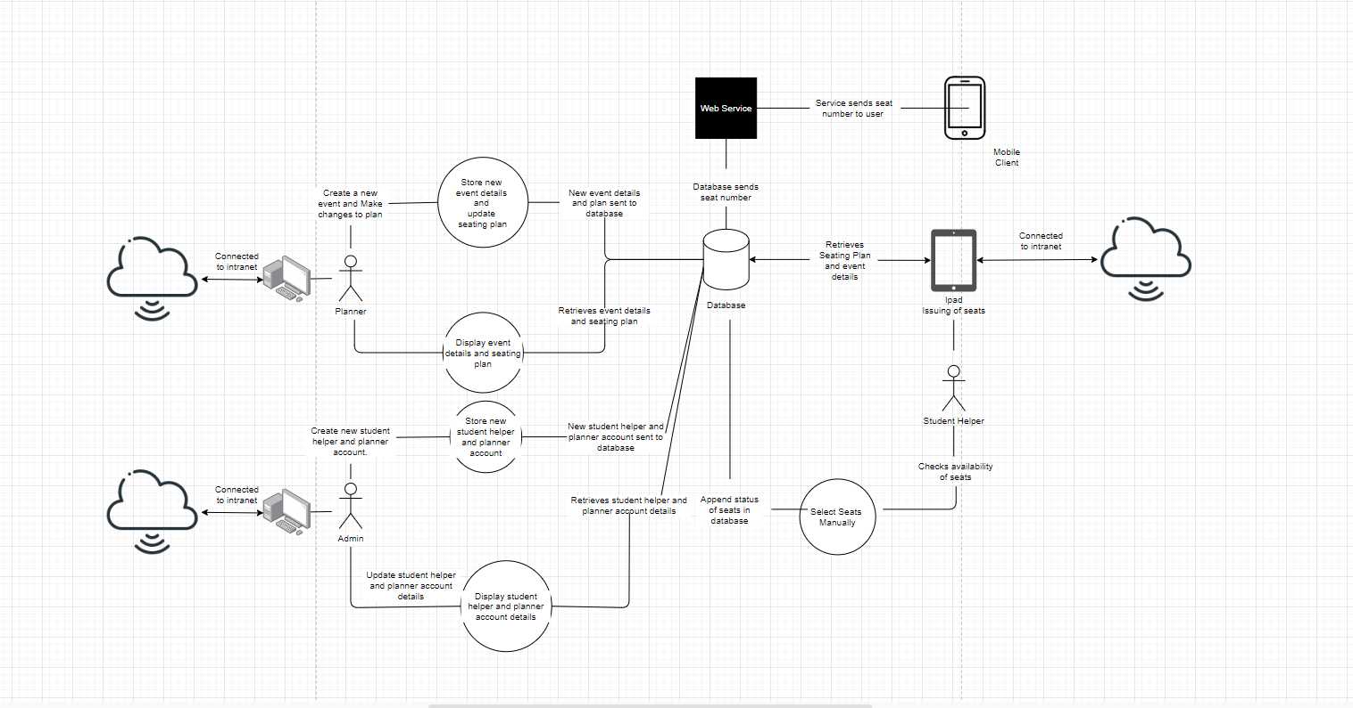
System Diagram

Slide 6
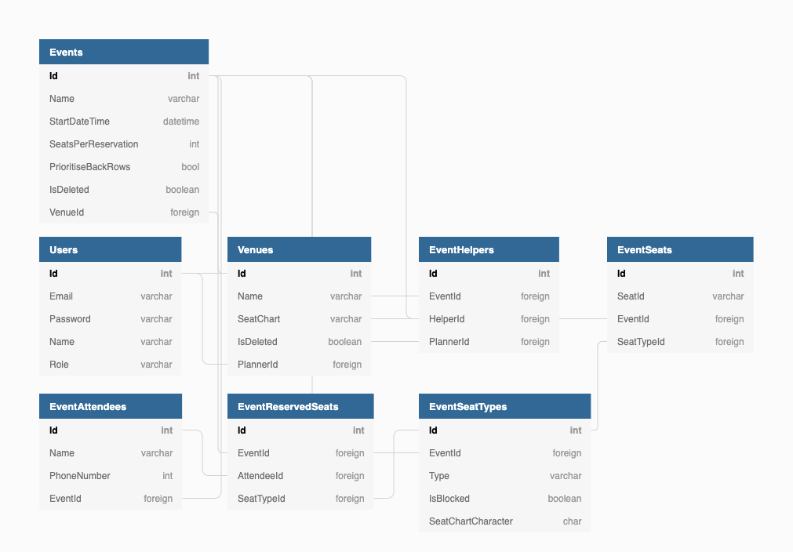
Schema Diagram

Slide 7
Work/Feature Allocation
For the job distribution, we have decided to split it by the three main roles
Admin
Planner
Student Helper
All of us did the UI together

Slide 8
Work/Feature Allocation
Vignesh
Planner Features (Event Creation)
Restructuring of the system
Creation of Venues
Lester
Administrator – Creation of Planner and Helper Accounts
Validations
SMS
Waiting List
Restructuring of the system
Bryan
Reservation of Seats (Helper)
Helper’s Seat Charting System

Slide 9
Demo
Notes:
So

Slide 10
Initial Plan From Week 1 - 6
Come out with a prototype for the system
Finalize system structure and database design
Complete database implementation and finalize front end design
Partial integration of both front-end and back-end

Slide 11
Work Done From Week 1 -3
For us the first 3 weeks on the project was working from home, so this is what we did:
We were tasked to come out with a prototype individually meaning there was 3 prototype, based on the previous batch’s documentation and codes.
By looking at the previous batch’s documentation and codes, we were able to understand the project much more clearly too.
From there, we were able to have a rough idea on what we wanted the final design to look like and draft our prototype accordingly
After producing the prototype, we went through different iterations each week to improve on our design and we finally settled on Vignesh's UI as it was the most visually appealing.

Slide 12
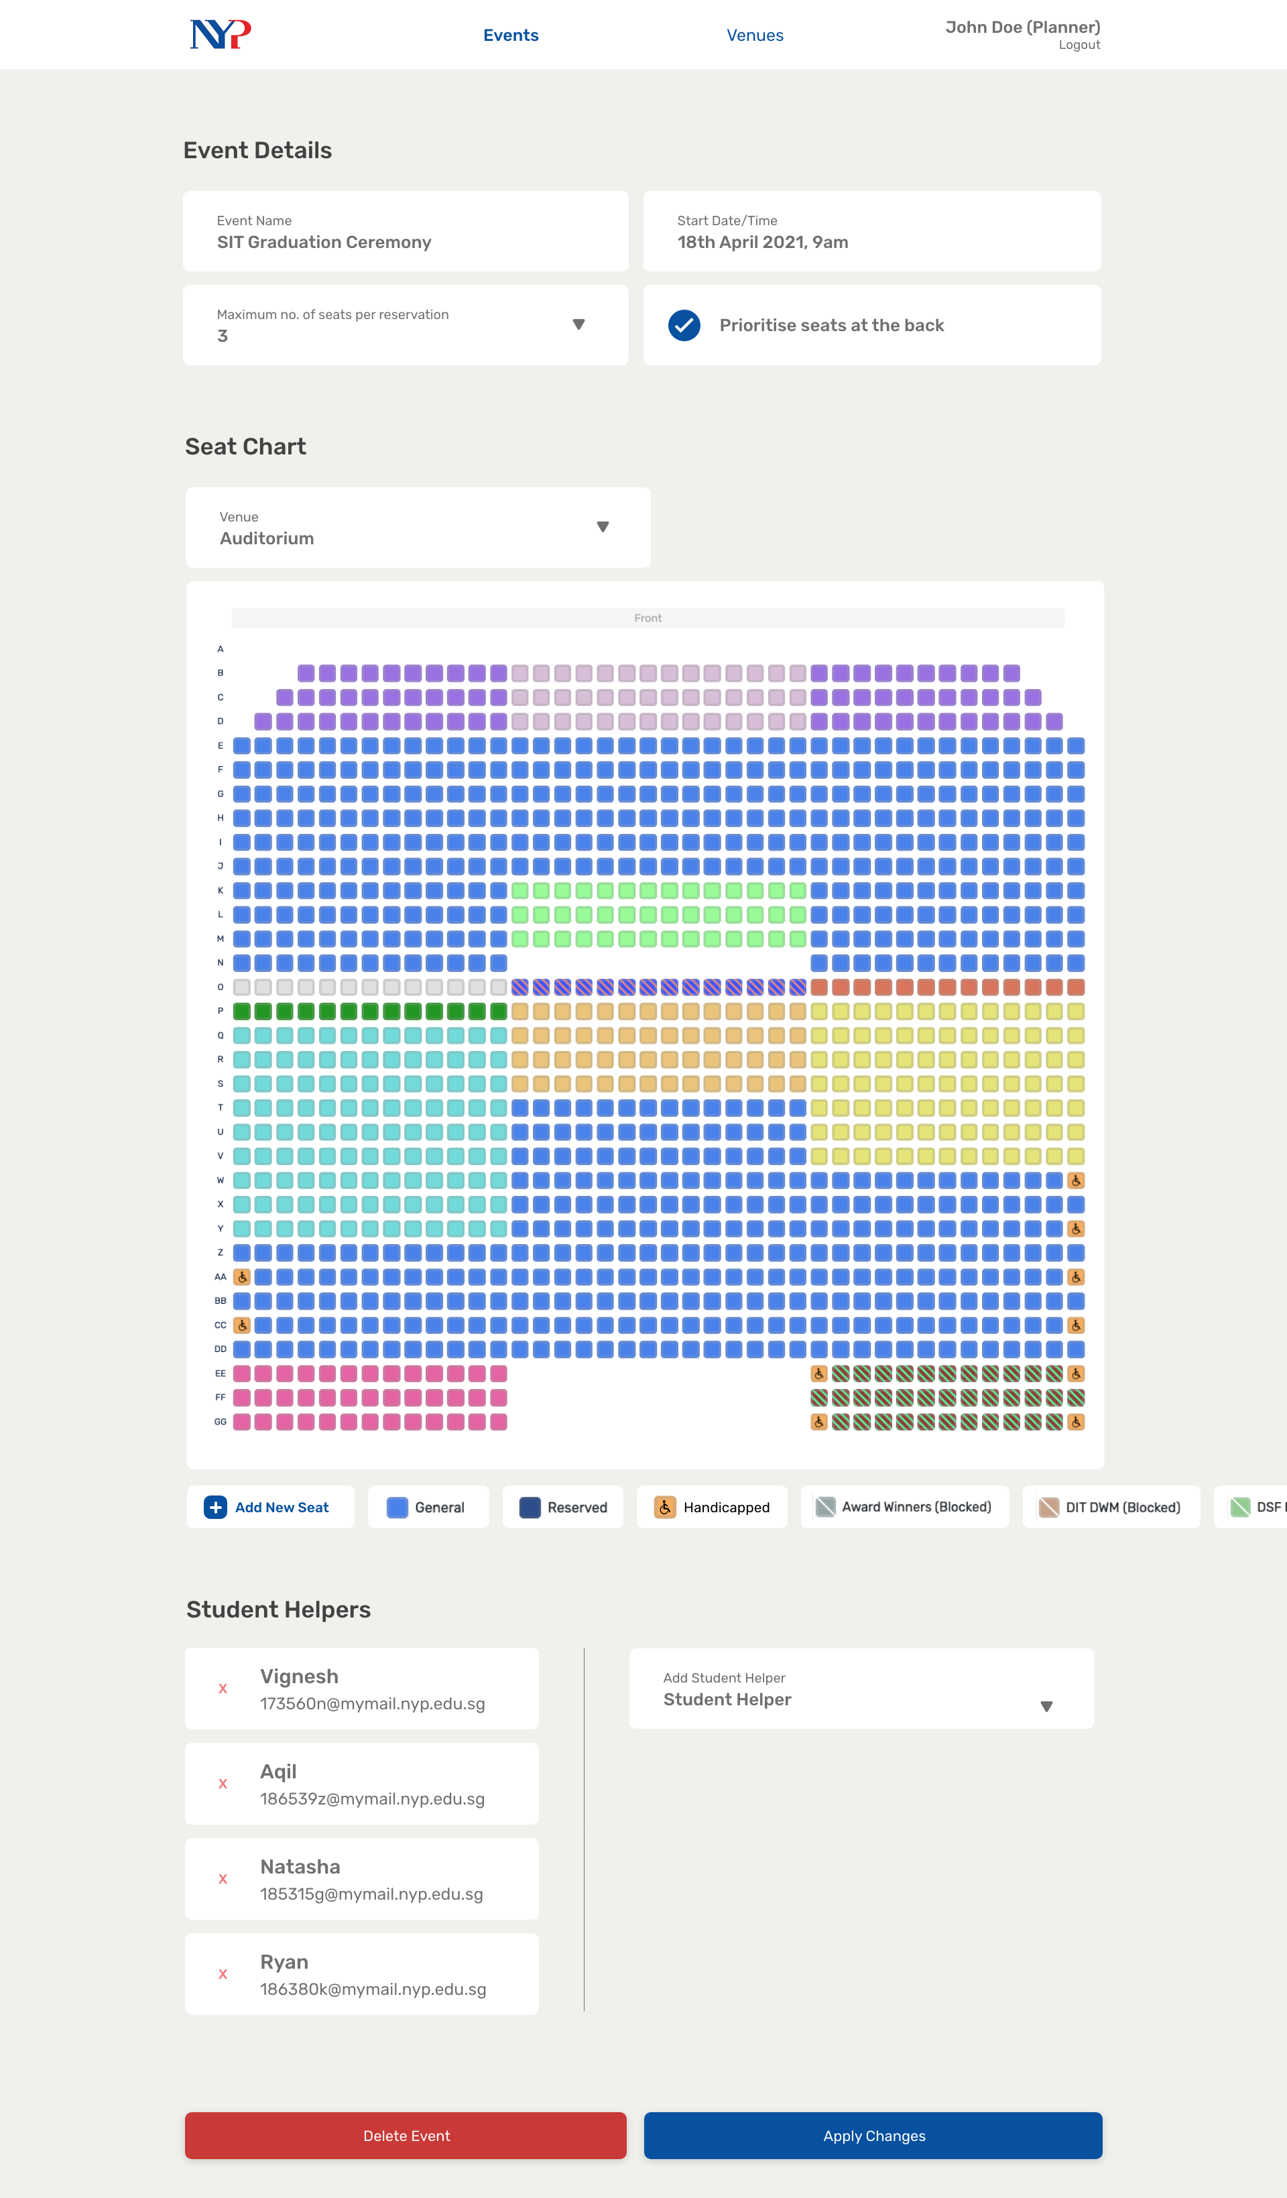
Notes:
45

Slide 13
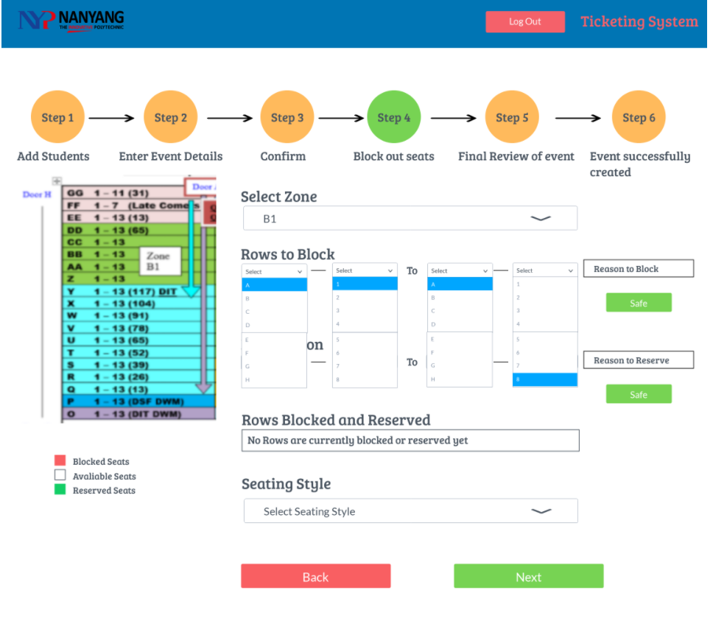
Notes:
45

Slide 14
Work Done from Week 3 - 6
Administrators
Create and Delete Helper & Planner Accounts
Planners
Add Events, which in turn should have the following details
Add and Delete Venues, which should have an accurate seat chart
Helpers
View Events and Event Details

Slide 15
Work Plan for Week 6 - 12
In the next 6 weeks, the app should include the following features:
Allow Administrators
Think of a way to allow admin to sort the list of planner/helper accounts by name, email
Or instead show the date of created so the admin is able to see clearer of how the table is group by
Another way is to add pagination
Allow Planner
Edit and Delete Events, which in turn should have the following details
Allow Helpers
Reserve seats in event
Search for existing reservations
Delete reservations
Put guests in waiting list if they exceed the mandated amount of seats per reservations
SMS Attendee their Seat Numbers
Hosting of the system

Slide 16
Challenges
Vignesh
Creation of the seating chart system, as I had to figure out a feasible method for us to integrate a flexible mapping system
Figuring out how to integrate the back end into the various features we have
Lester
Adapting to and understanding of the new programing language which is, NodeJS and JavaScript, as I am not very experienced with it, compared to C#/Asp.net which I have more experience in.
Bryan
Similarly to what Lester has mentioned, due to a lack of experience in developing in Javascript, it was really difficult to understand all the new and different syntax and functions of the language itself. Additionally, I struggled during the implementation of the database since I am using an IDE that I have very little exposure to.

Slide 17
Overcoming these Challenges
Vignesh
In the end, I settled on using seat plugin as a base and then experimenting with it to find ways to customize the mapping system to fit the application needs
As for the back end, using a database wrapper made integration relatively painless
Lester
As, I was relatively new to the programming language, JavaScript, what I did to overcome these challenges was to look up tutorial videos online and create a simple TODO list application. Furthermore, I also seek help from Vignesh who is much more experienced in the programming language.
Bryan
Likewise, being new JavaScript I had to constantly search for tutorials online and also refer to different communities such as (Reddit and Stack Overflow) for resources to aid in the understanding of the new language. My teammates were also really helpful during the learning process as they patiently sat down with me to help me understand the various blocks of codes in our project

Slide 18
Thank you!

Slide 19
Job Scope
App should be able to
Allow Administrators
Create and Delete Helper & Planner Accounts
Allow Planners
Add, Edit and Delete Events, which in turn should have the following details
Name
Start Date Time
Venue
Maximum number of seats per reservation
Whether they should prioritize back rows
Different seat types
Blocked seats
Helpers assigned
Add and Delete Venues, which should have an accurate seat chart

Slide 20
Job Scope
App should be able to
Allow Helpers
View events
Reserve seats in event
Search for existing reservations
Delete reservations
Put guests in waiting list if they exceed the mandated amount of seats per reservations
SMS Attendee their Seat Numbers

Slide 21
Job Distribution
Vignesh
Planner Features (Venue and Event Creation)
Lester
Administrator
All Role’s Dashboard
Bryan
Authorization & Validation
Reservation of Seats (Helper)
Helper’s Seat Charting System

Slide 22
Job Distribution
For the job distribution, we have decided to split it by the 3 roles, Admin, Planner and Student Helper
However, we have also agreed on helping one another, if any of us needs helps.
This implies that we might not only do the features tied to the role we oversee; we might do other features tied to other roles.

Slide 23
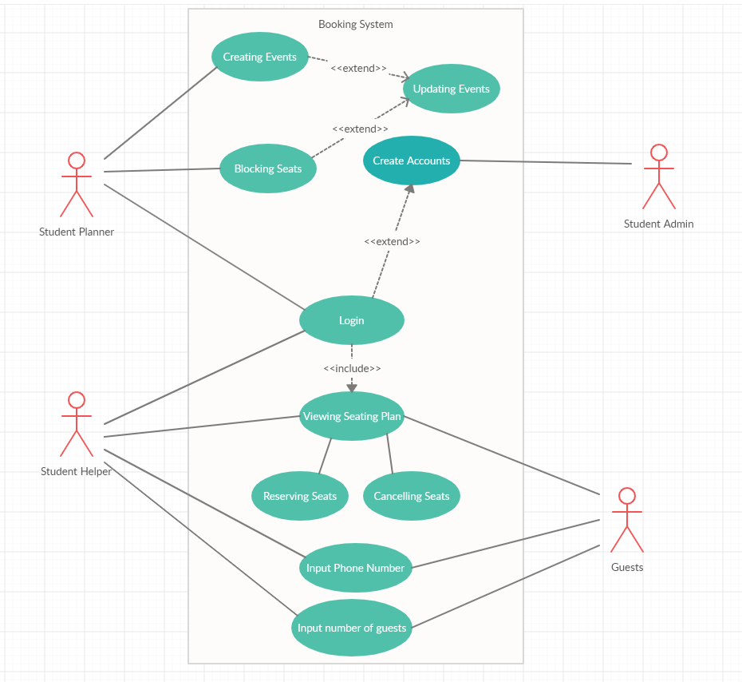
Use Case Diagram

Slide 24
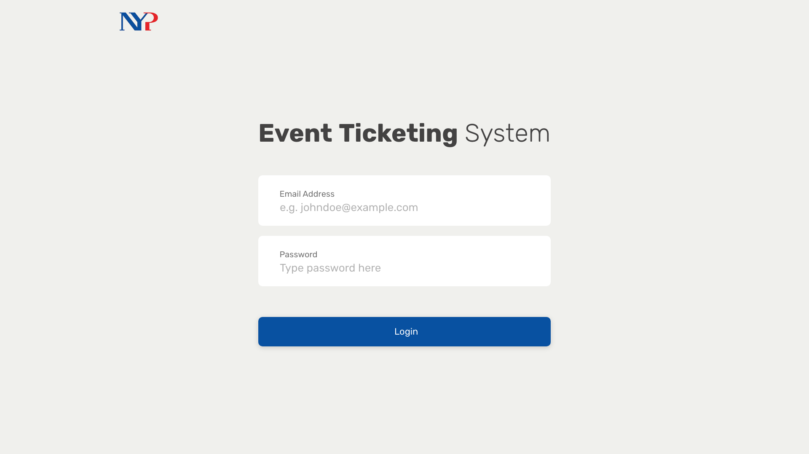
Notes:
We start with the login screen (nothing remarkable)
We might not even have a login screen depending on whether Oauth might work for our project
Anyway, a student will now login to the system.

Slide 25
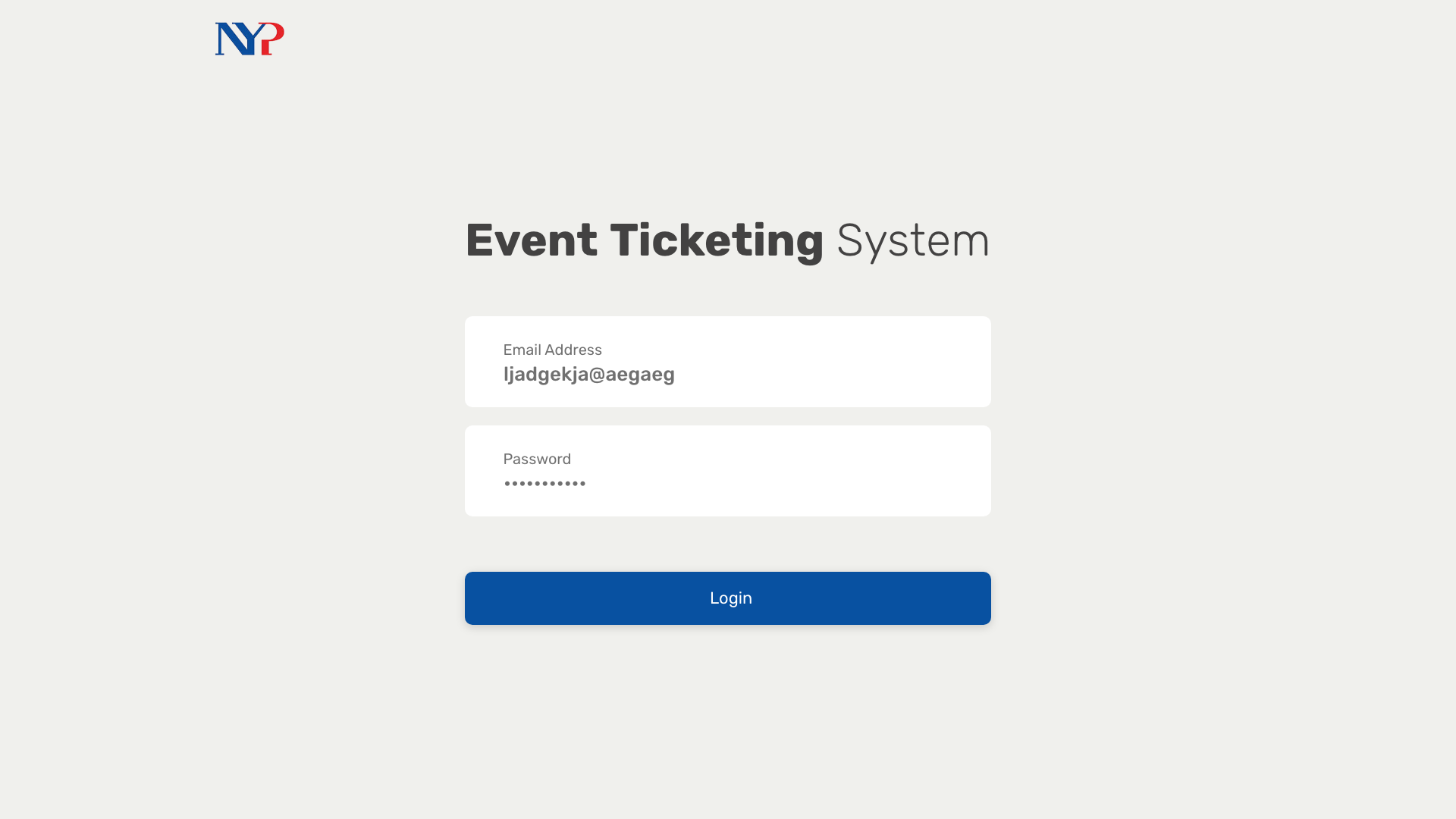
Notes:
Upon entering, they’re presented with this screen where they can view events they are helping with in a more visually appealing manner.
Once they click on one of these event cards, they can view more details.

Slide 26
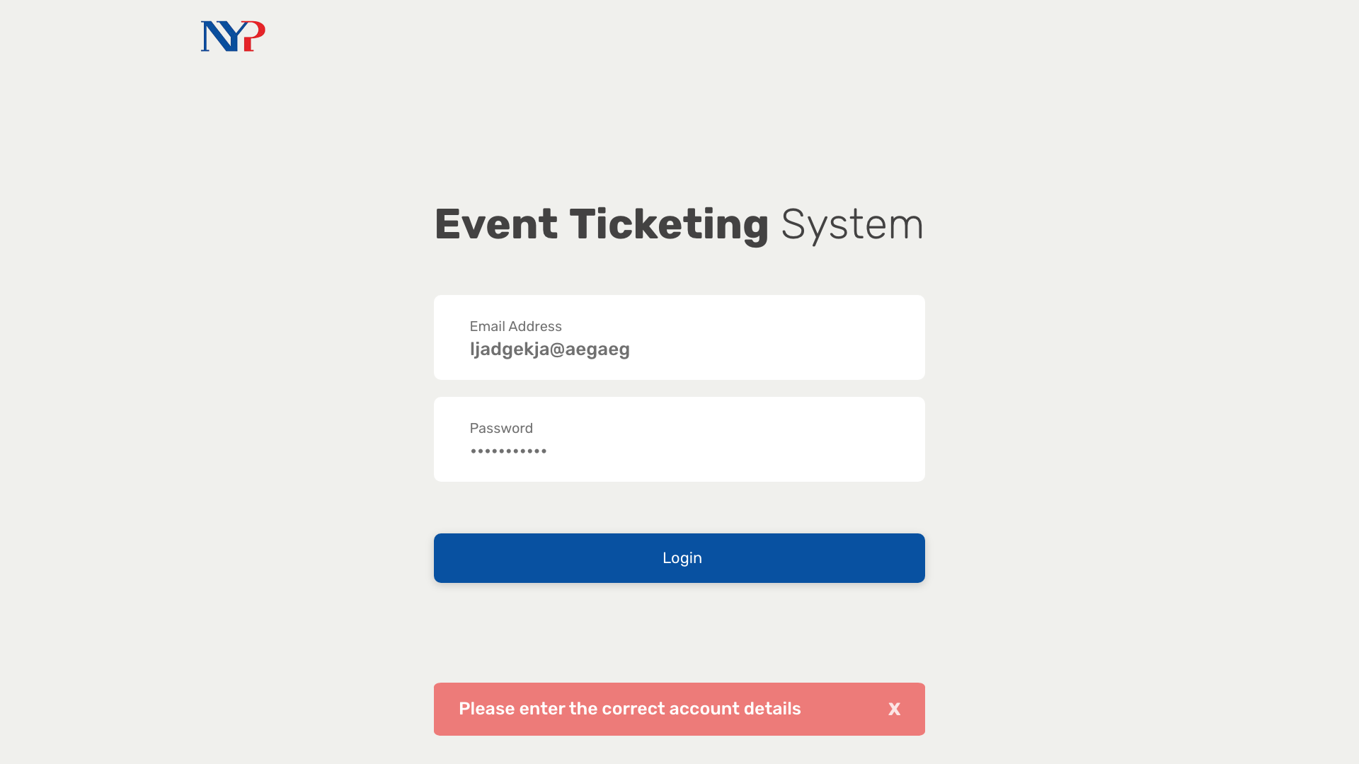
Notes:
So here, they can see the seats that are already reserved in a table form.
They can then choose to reserve a new set of seats by pressing the button.

Slide 27
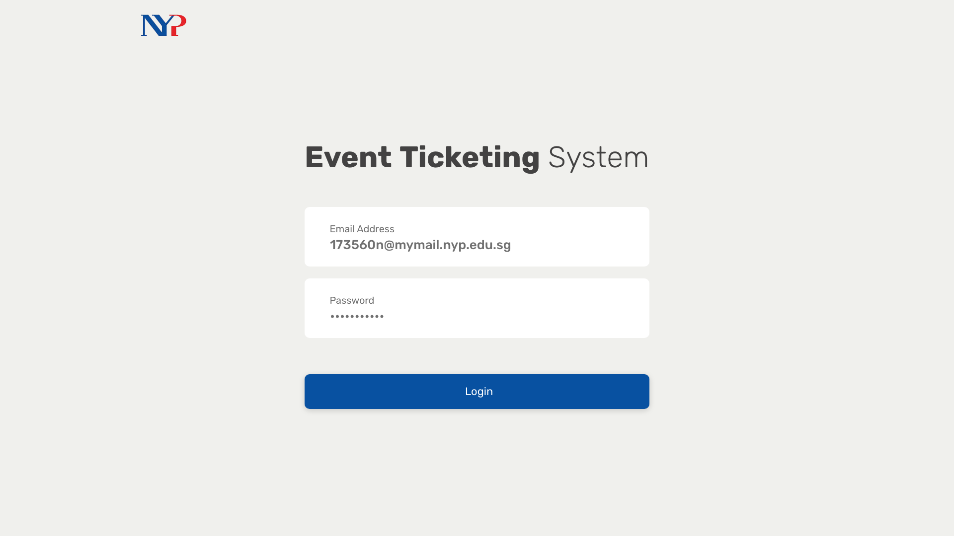
Notes:
over here, i'm using a functional seat chart to show the student helper all the seats that are available in a more visual manner. they can then select the seats they deem fit for the attendees.
after doing so they just have to enter the contact details to send them their tickets via SMS
warn student helper when not booking seats according to criteria (top -> down)
block seats at event creation
able to change handicapped seats for each event
add more validation

Slide 28
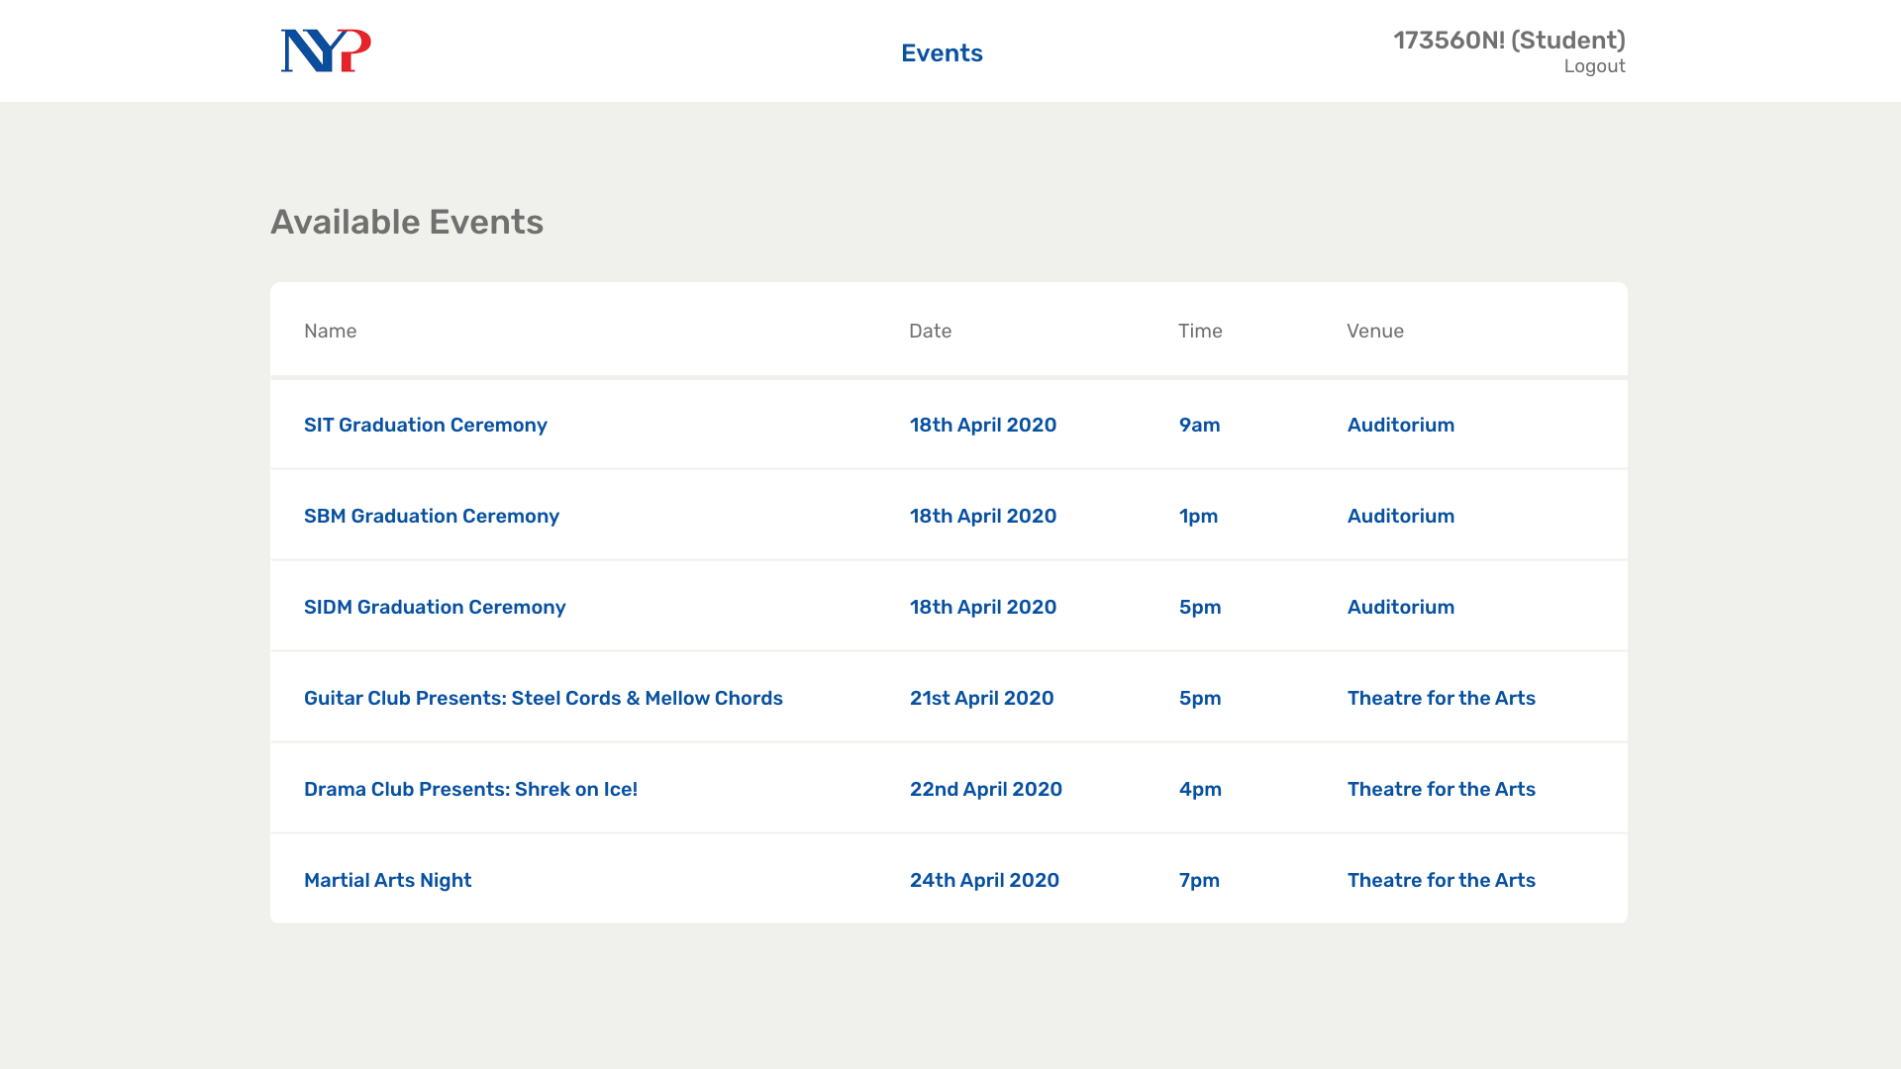
1
Notes:
And after this process is done, they

Slide 29
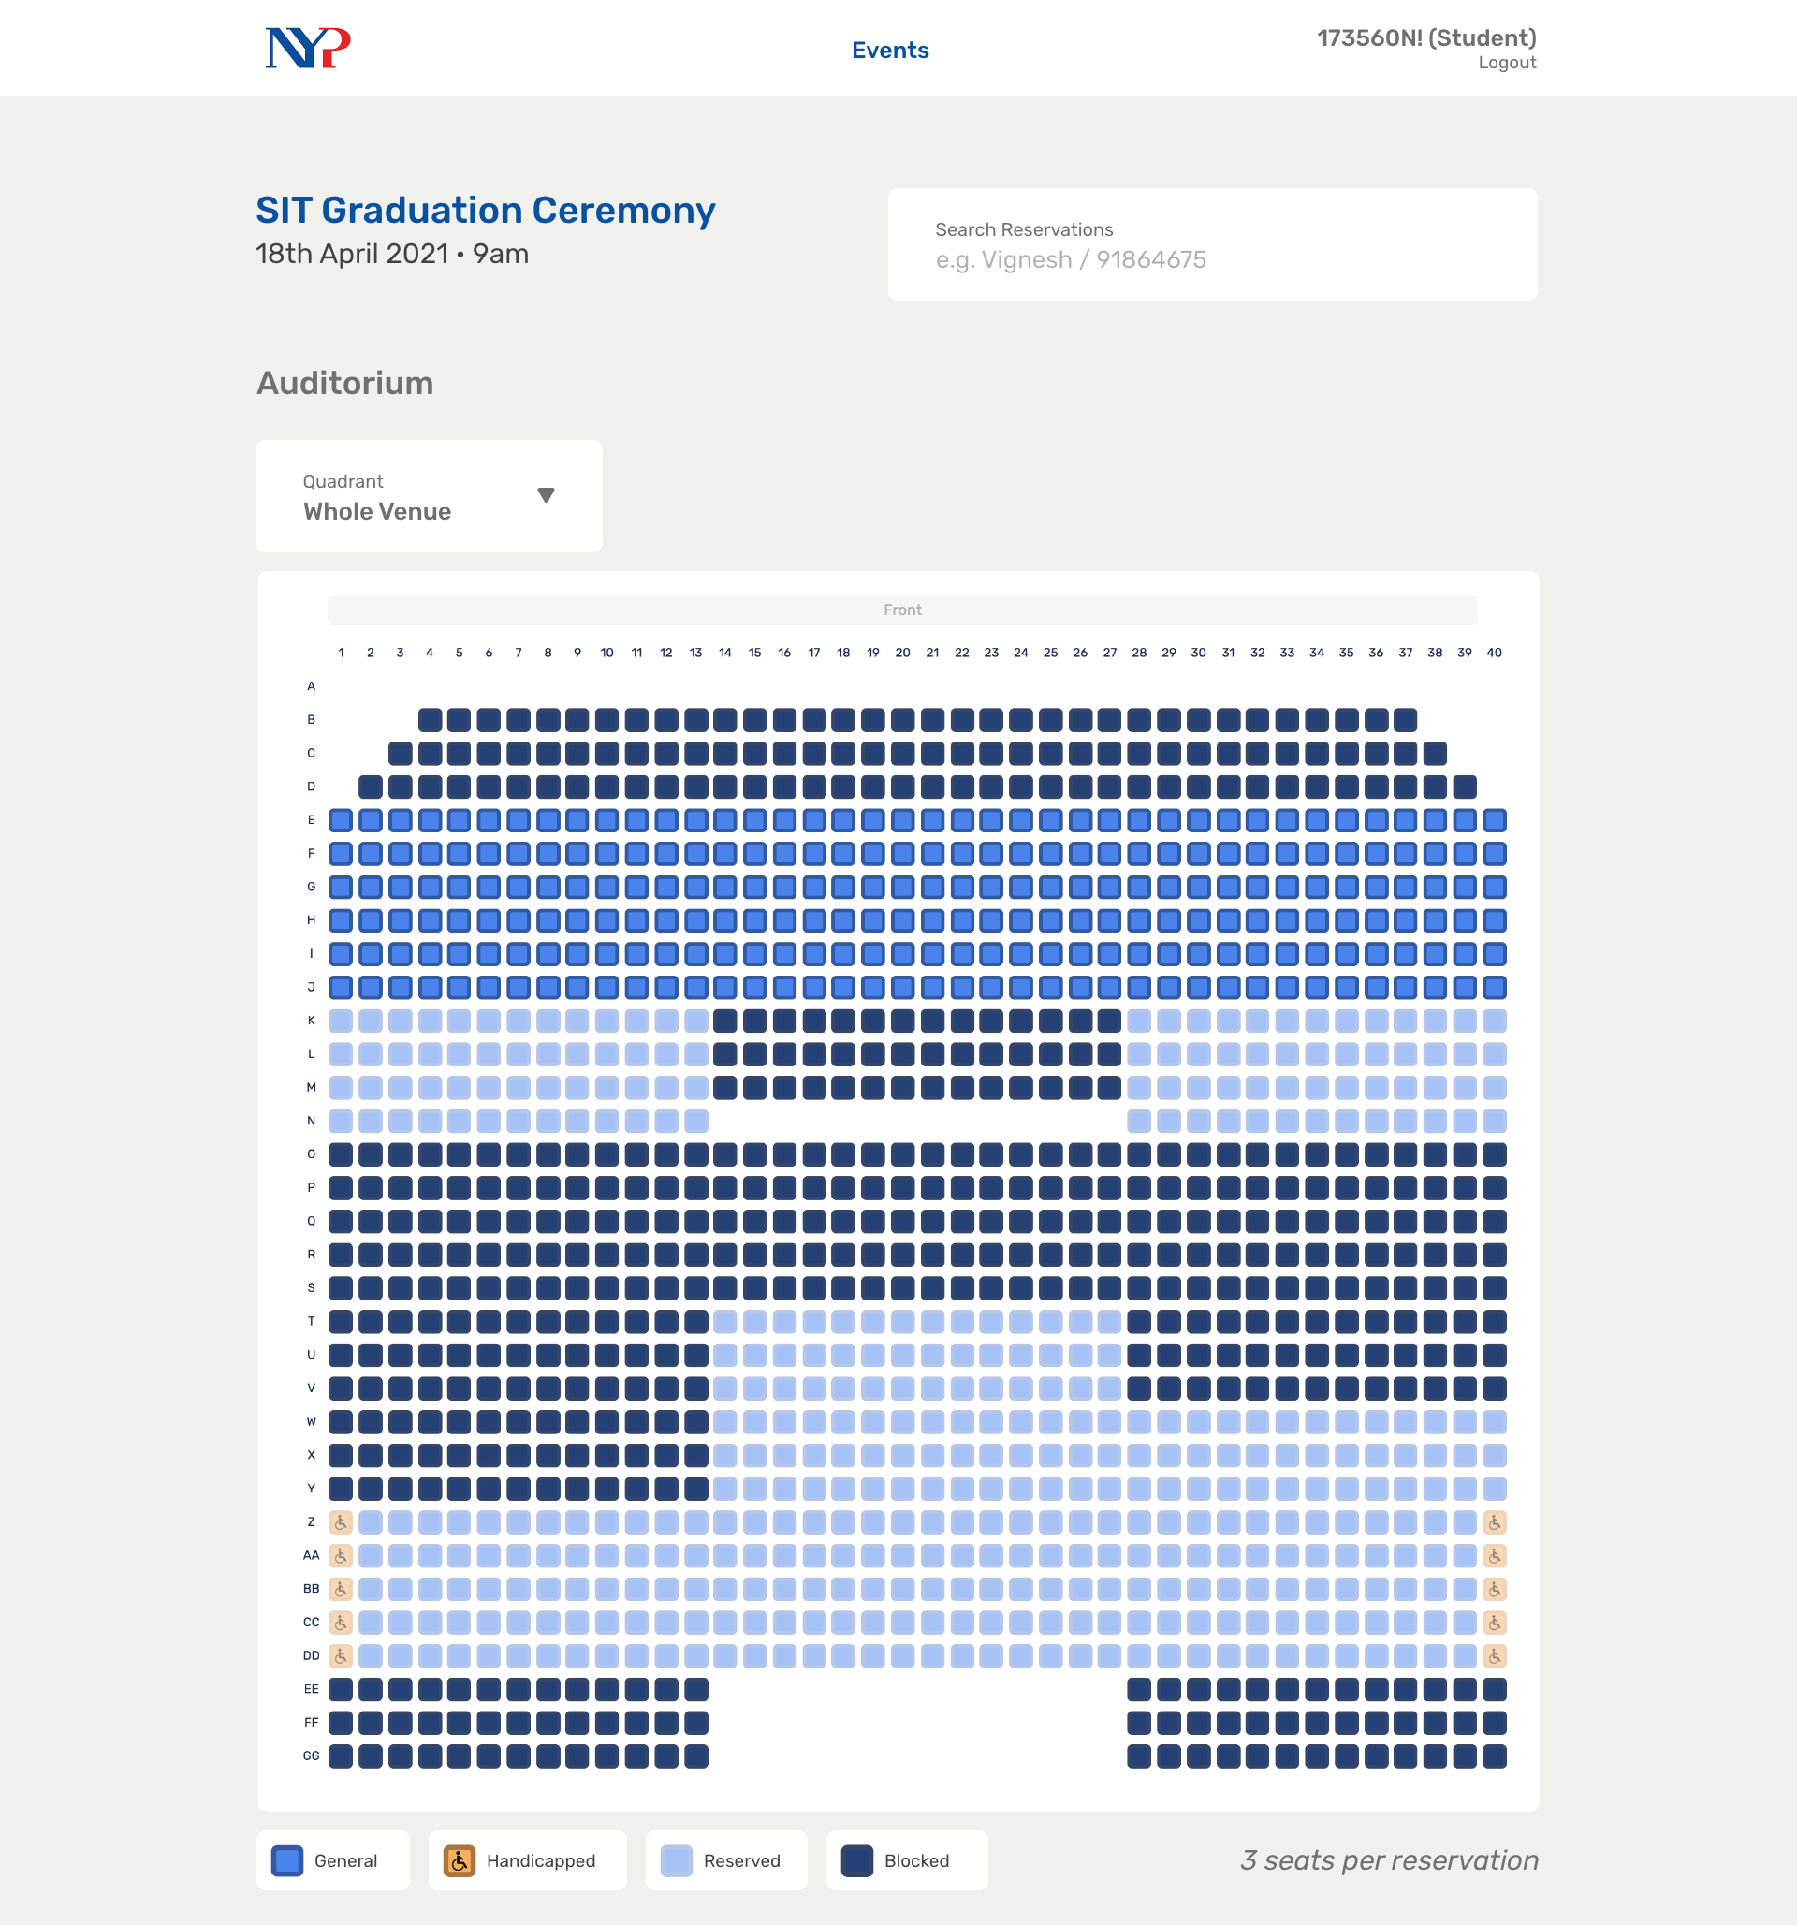

Slide 30
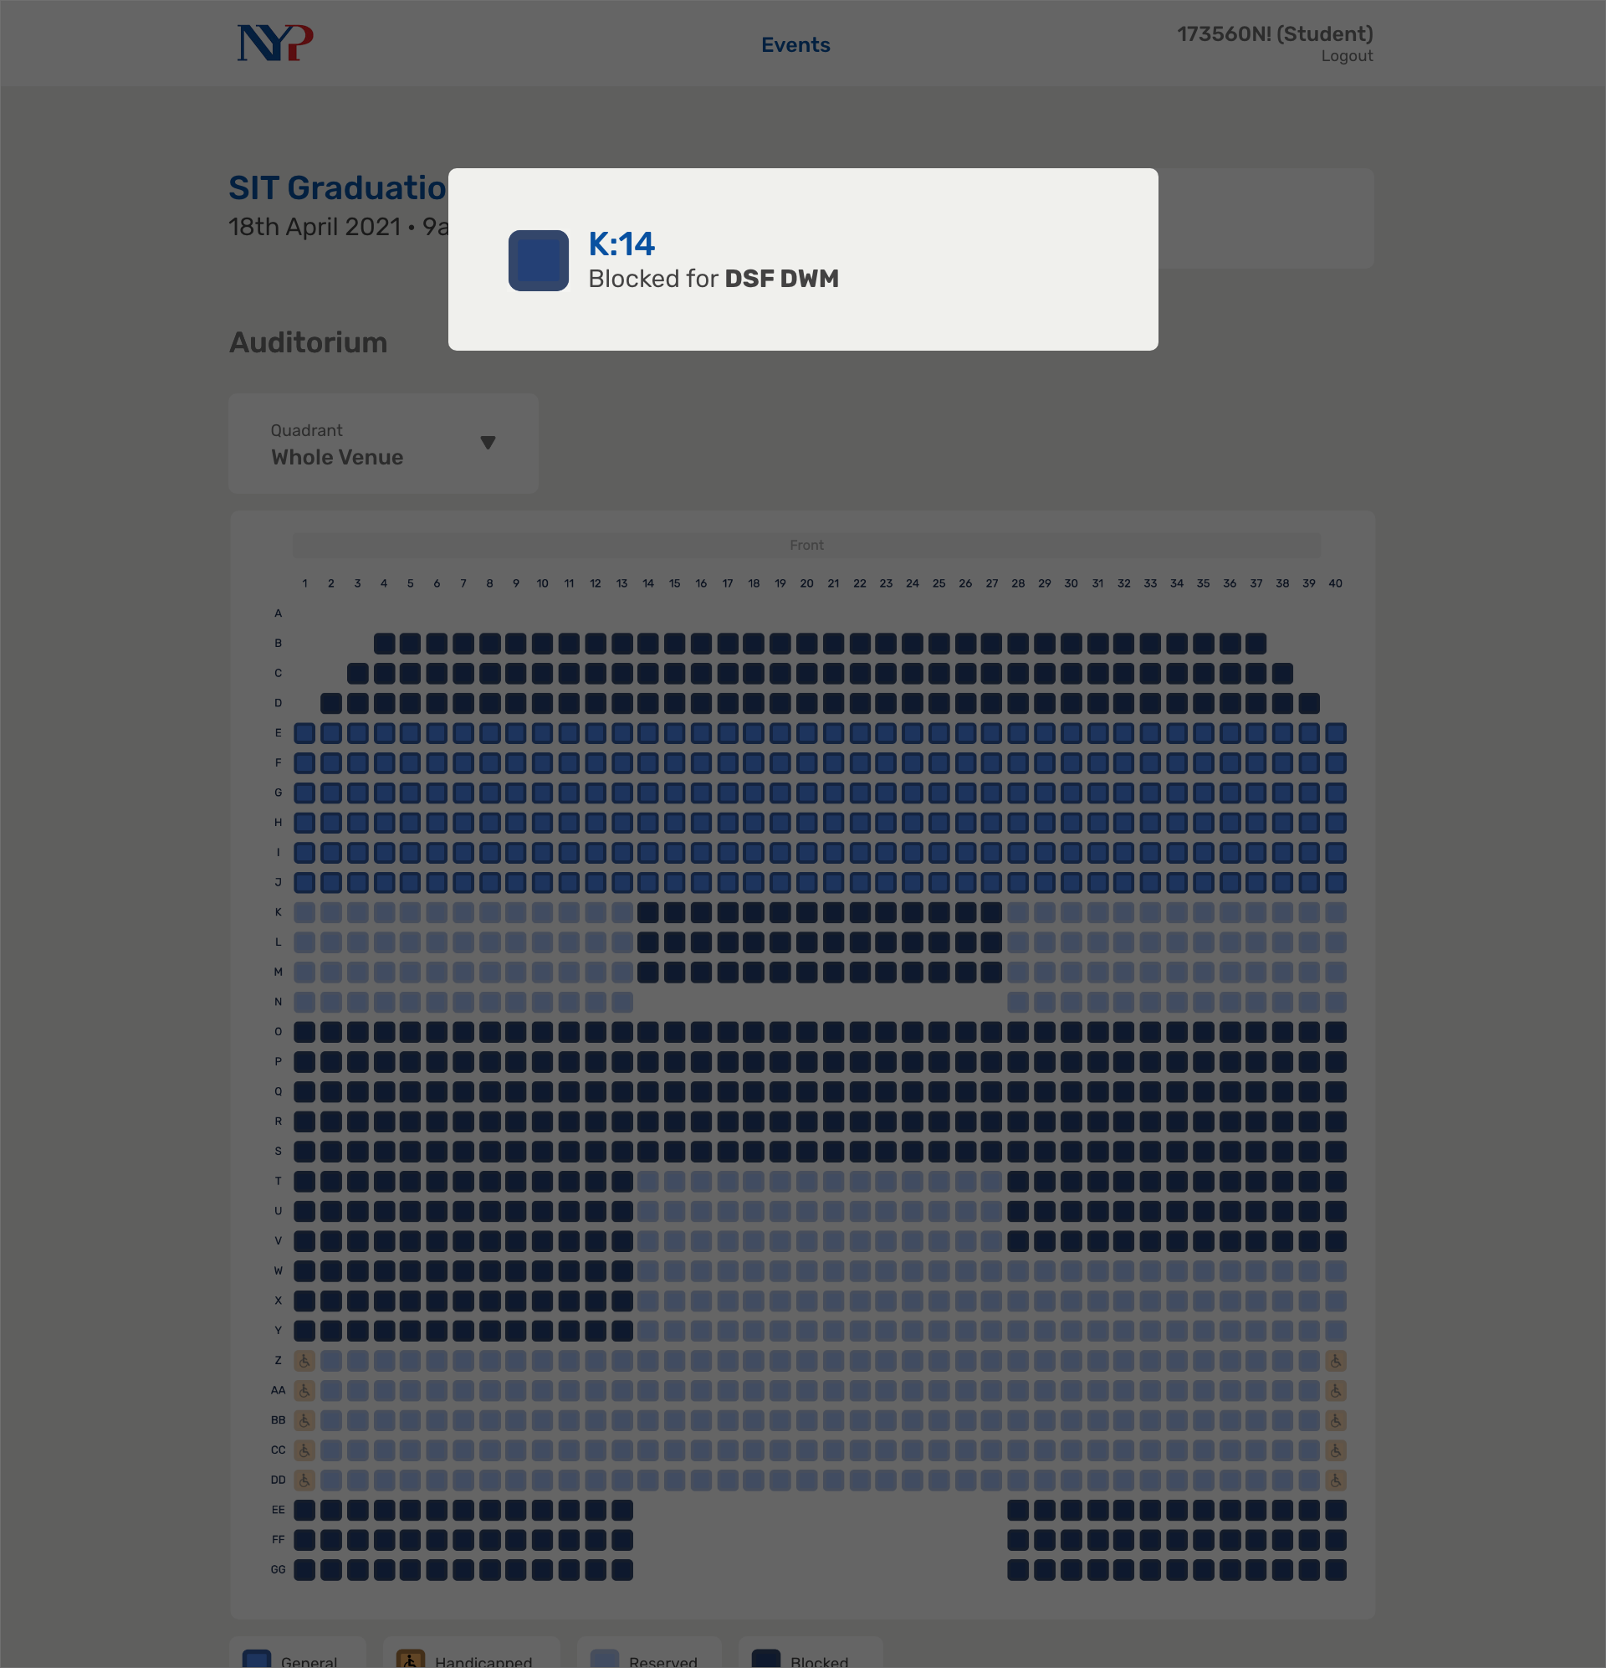
Notes:
7

Slide 31
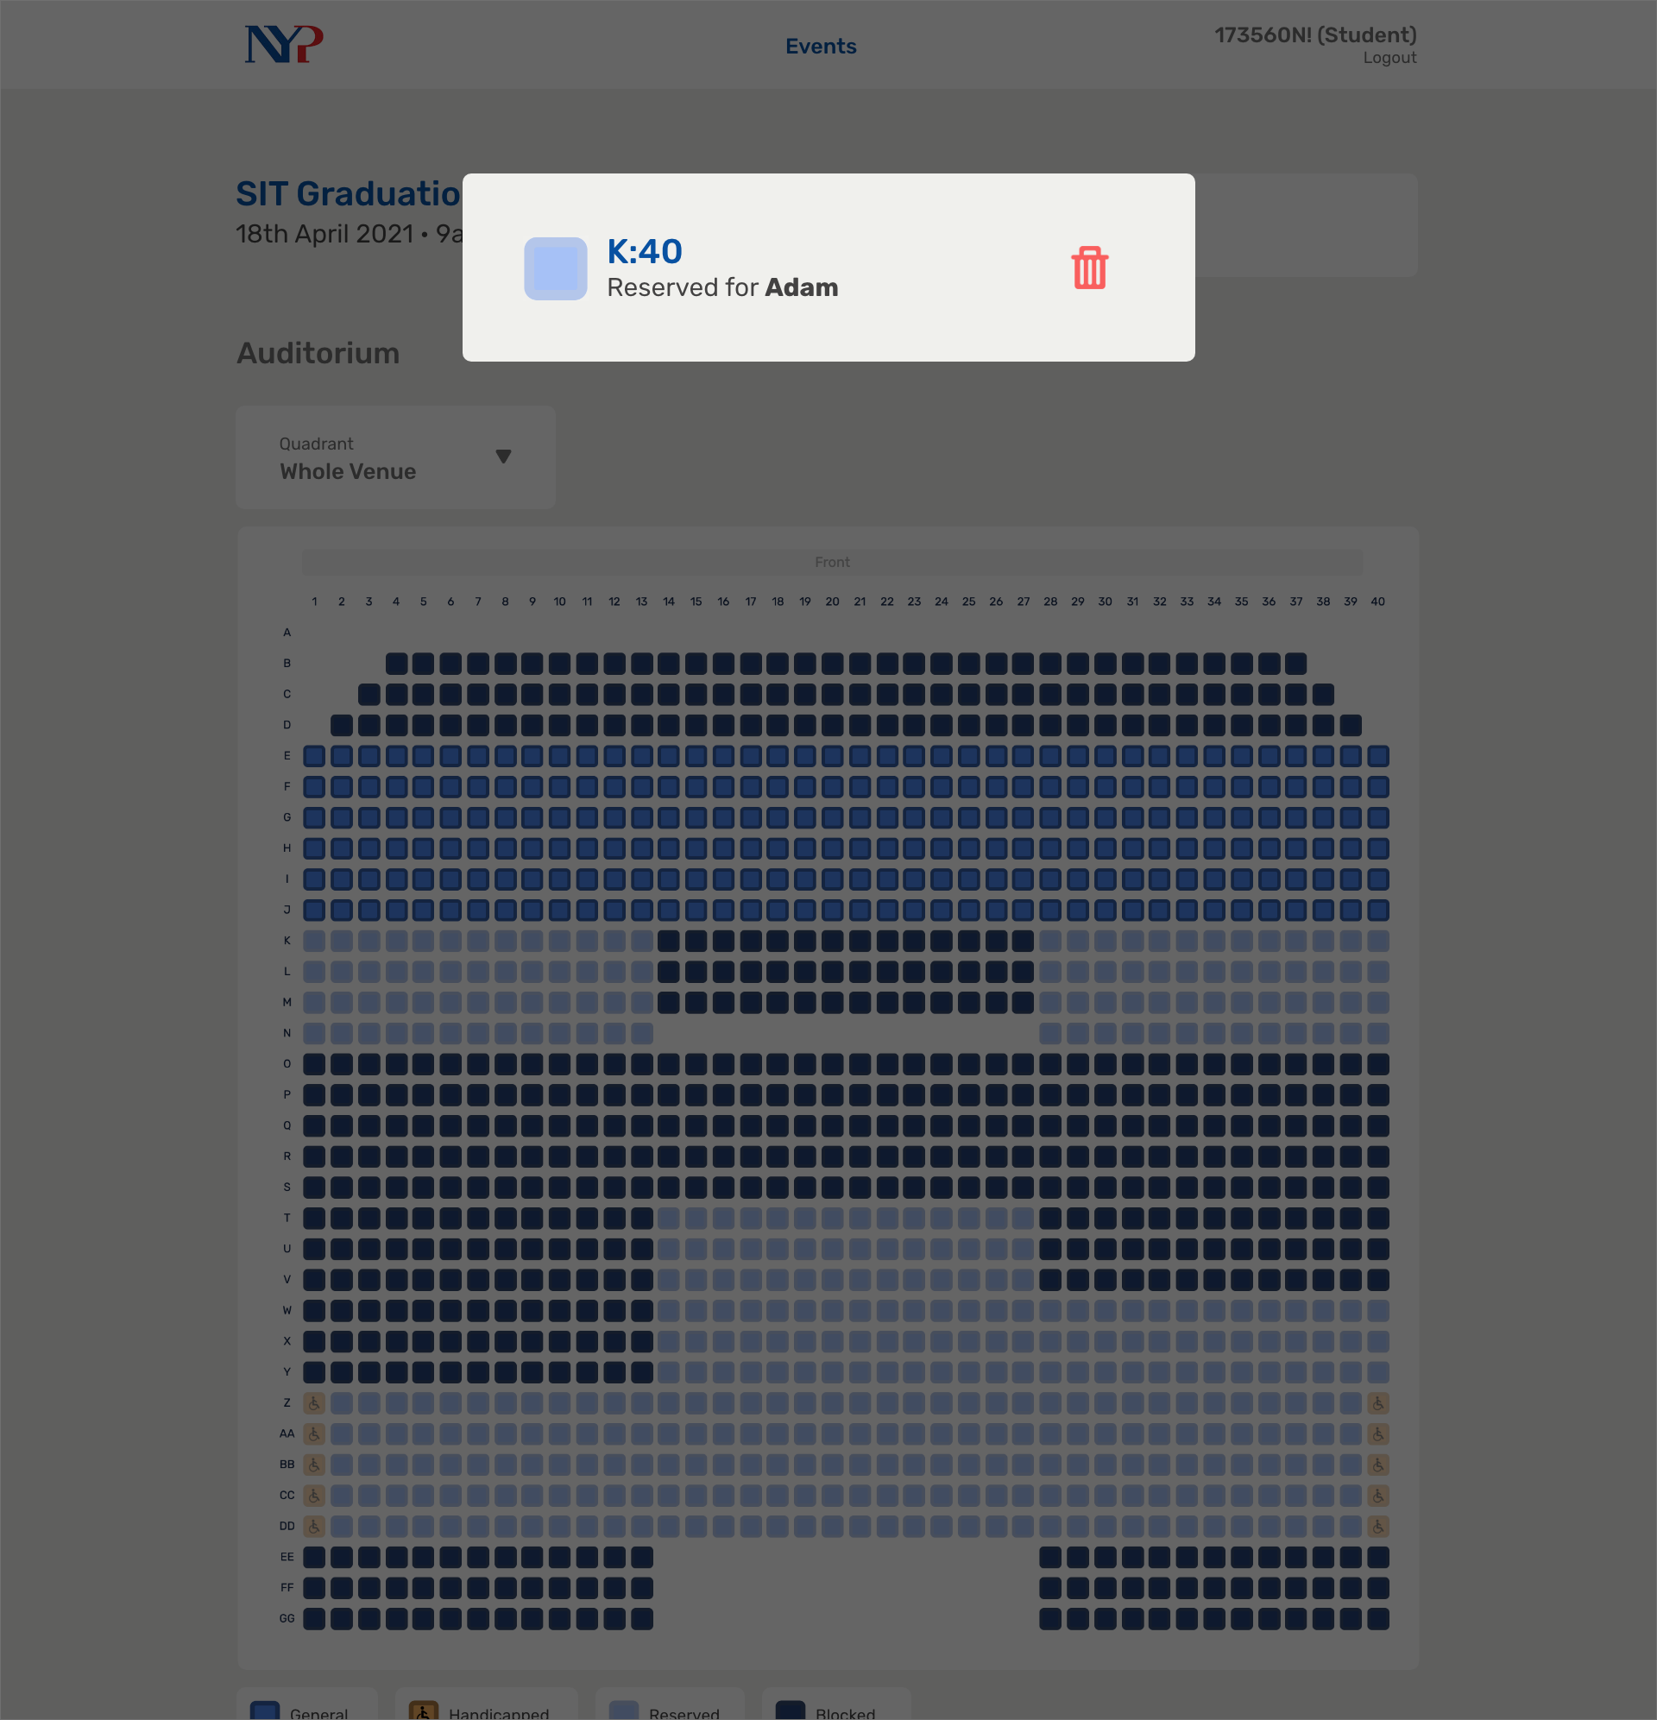
Notes:
8

Slide 32
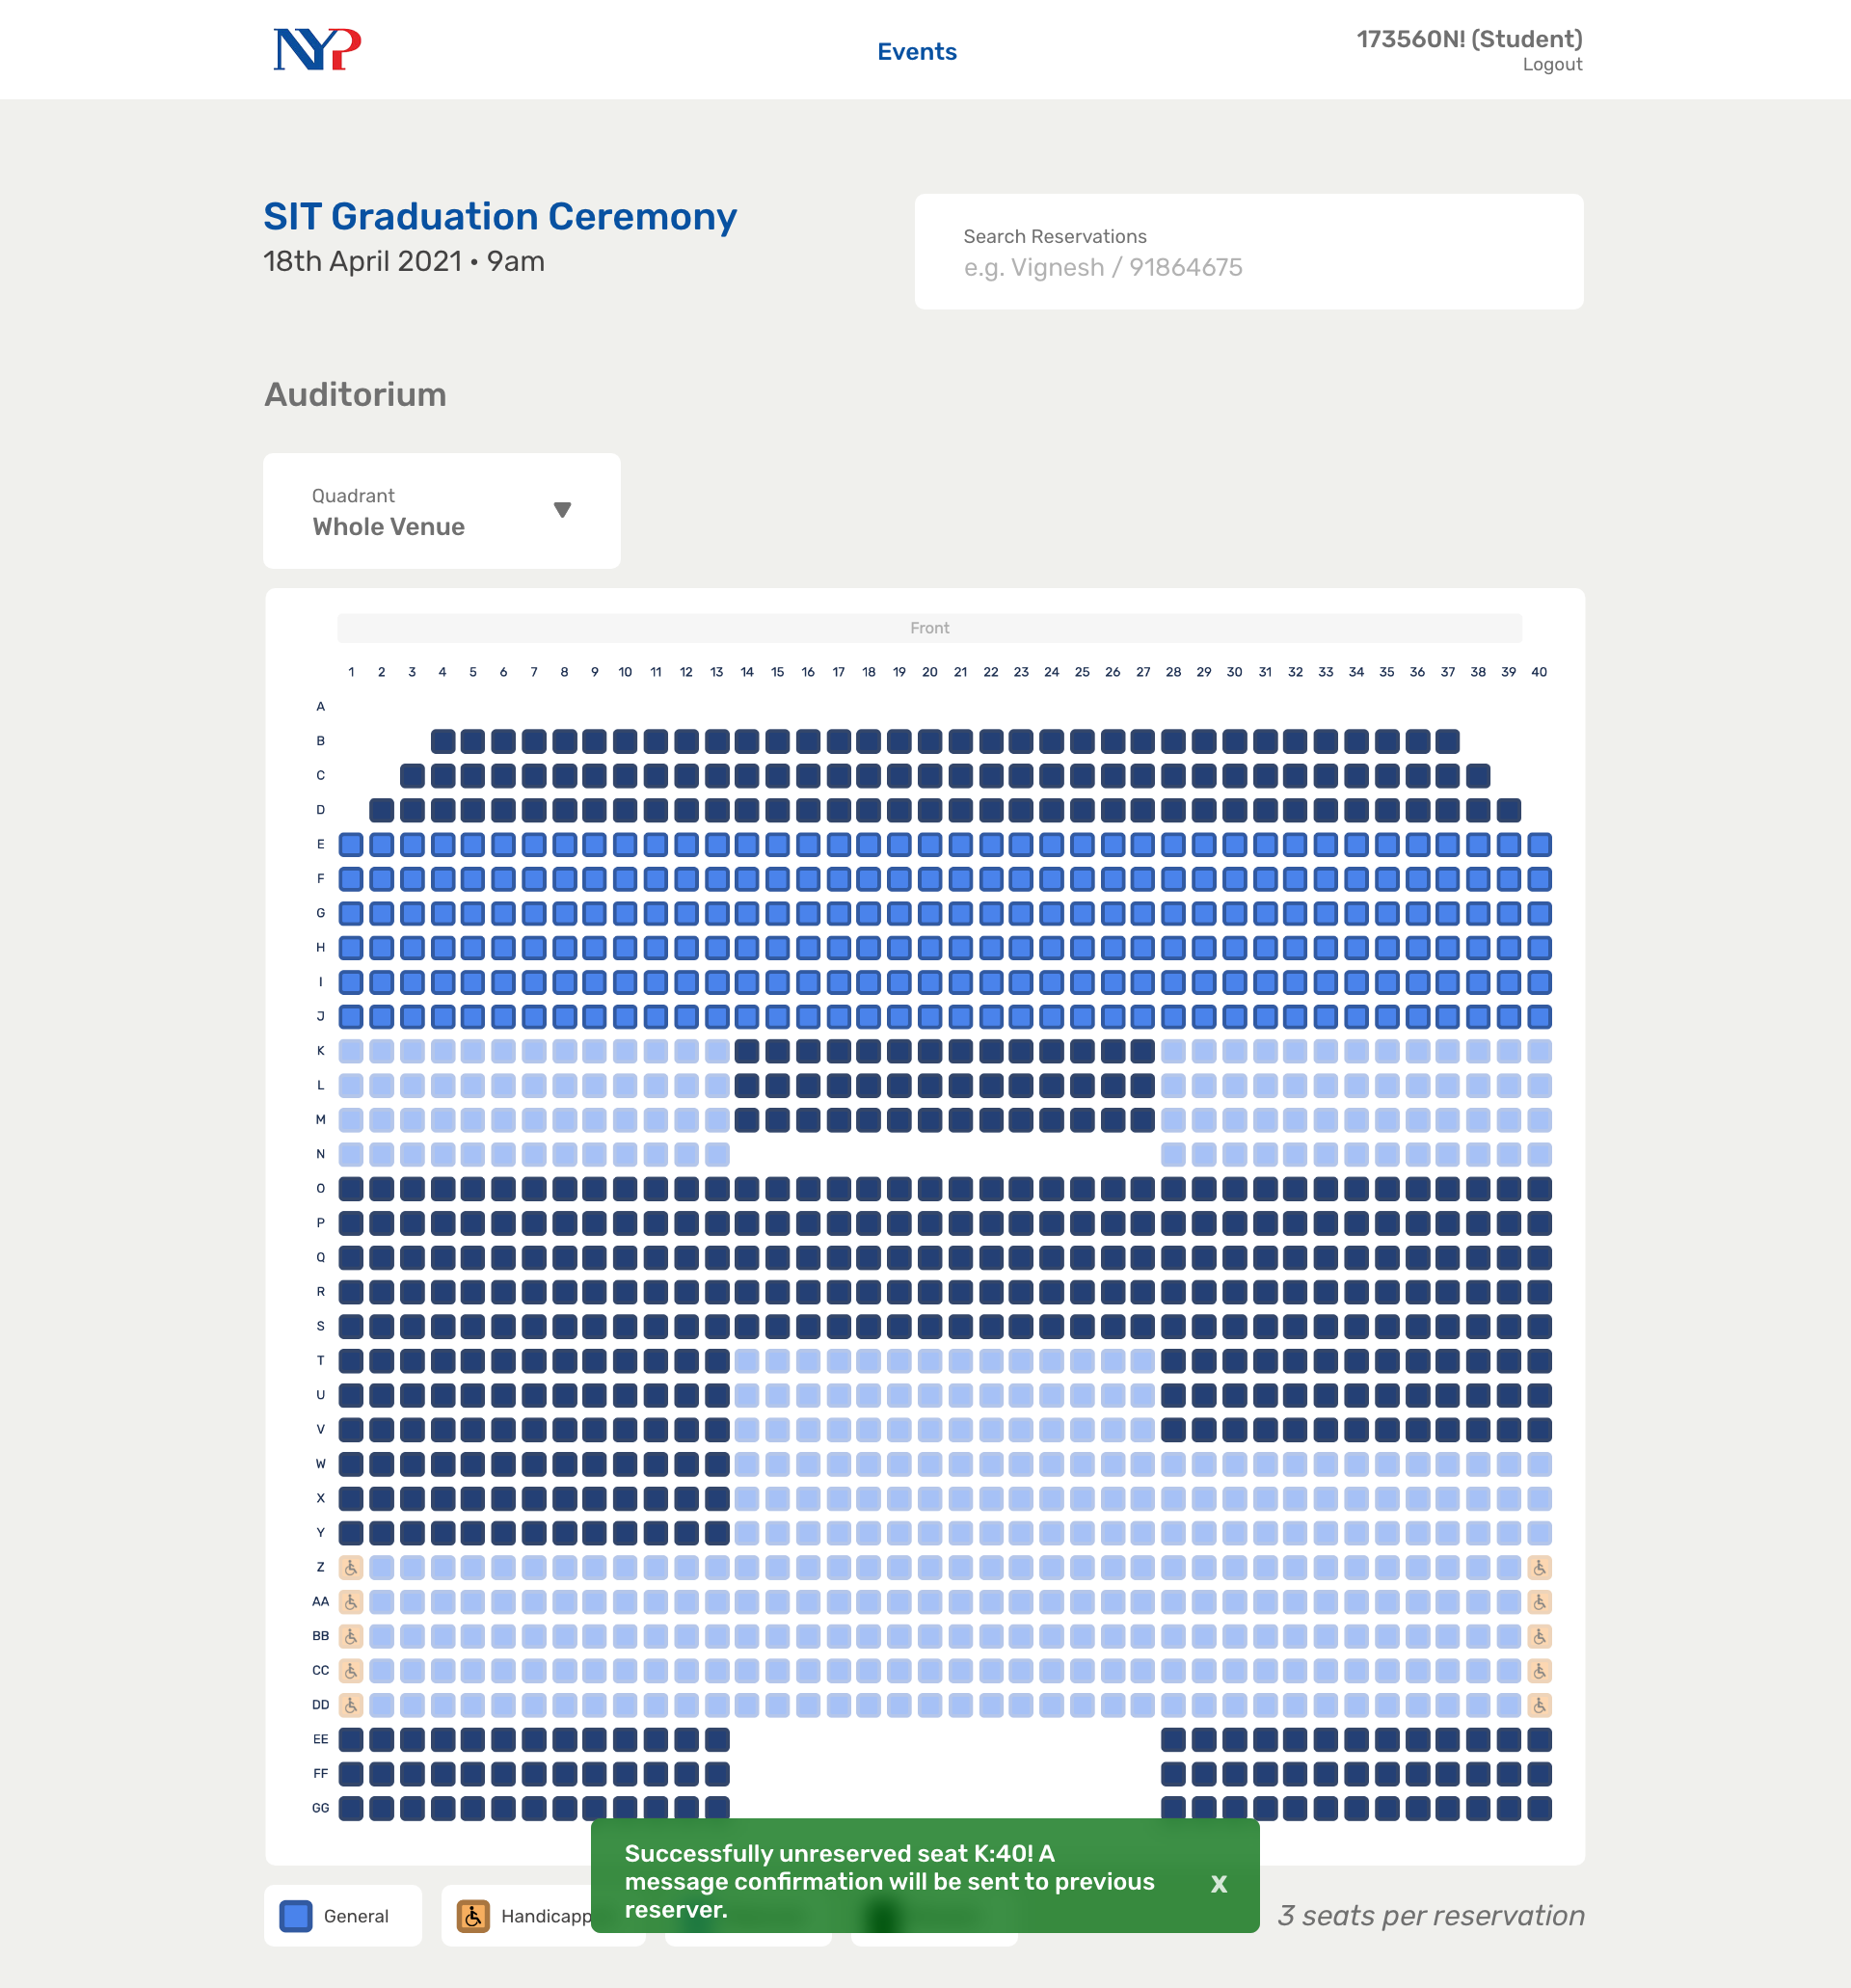
Notes:
9

Slide 33
Notes:
29

Slide 34
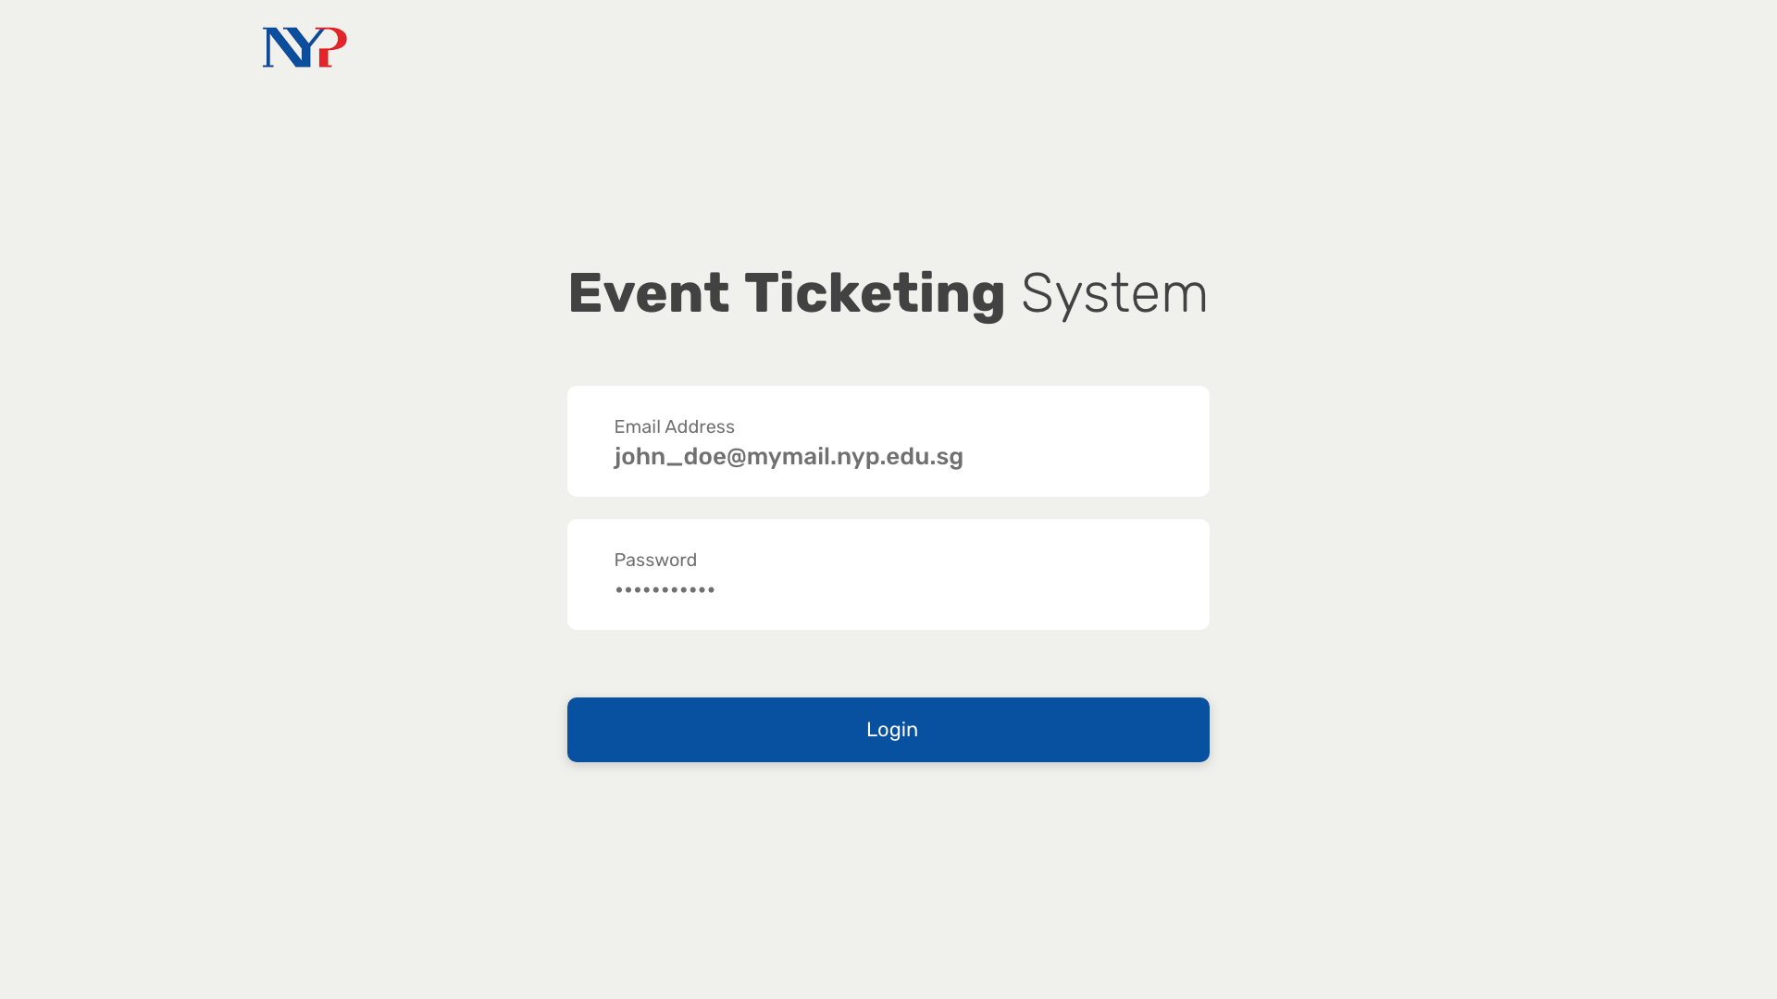
Notes:
30 Planner

Slide 35
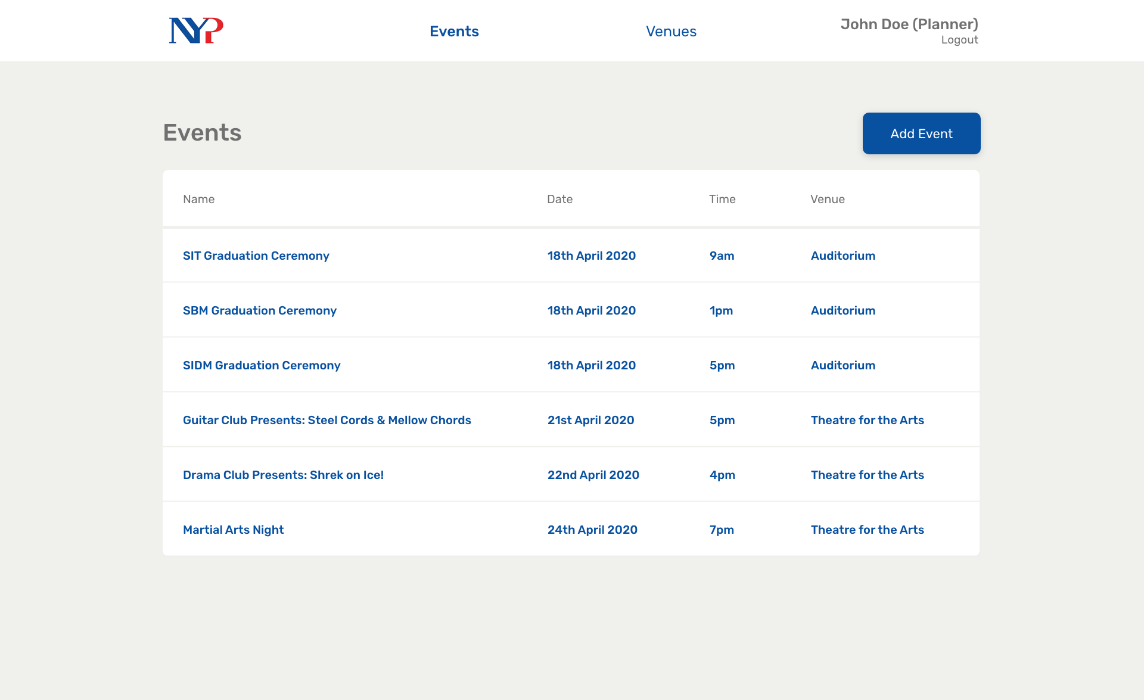
Notes:
31

Slide 36
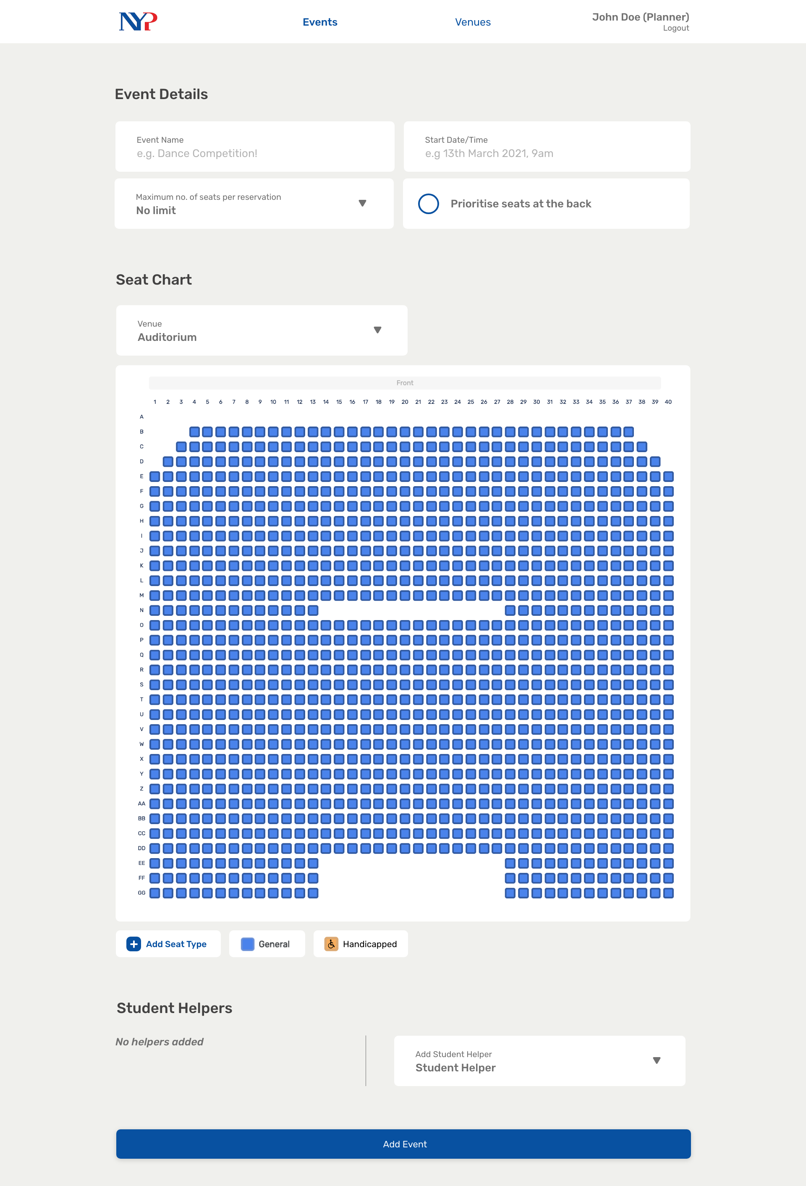
Notes:
32

Slide 37
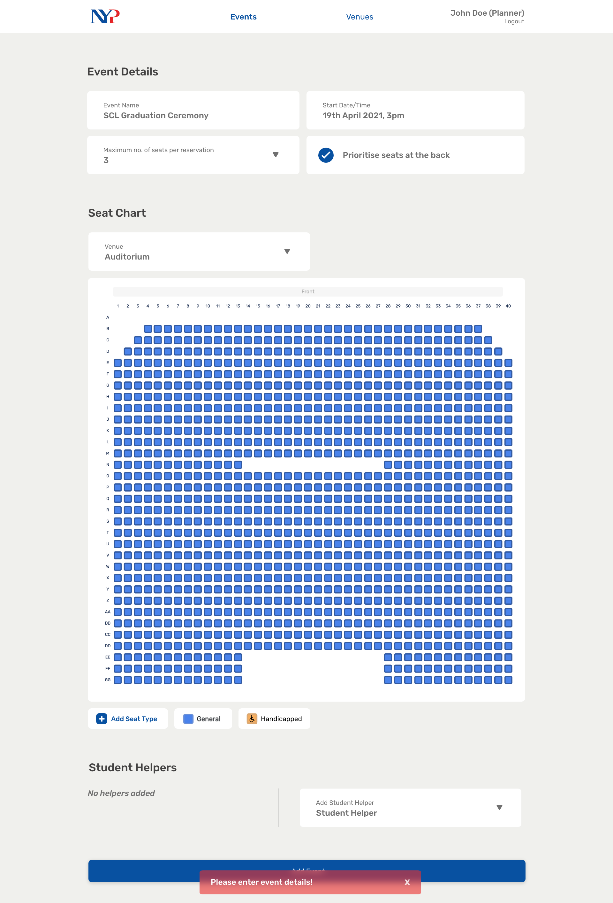
Notes:
33

Slide 38
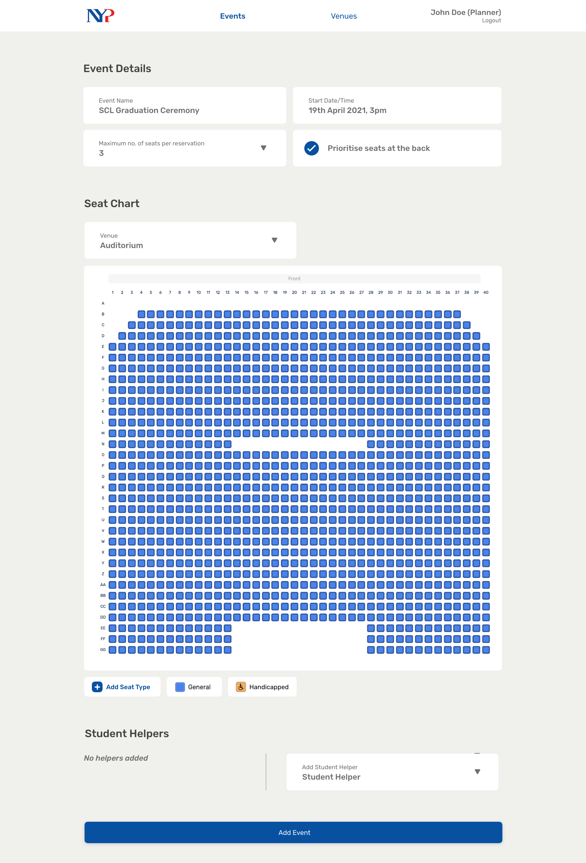
Notes:
34

Slide 39
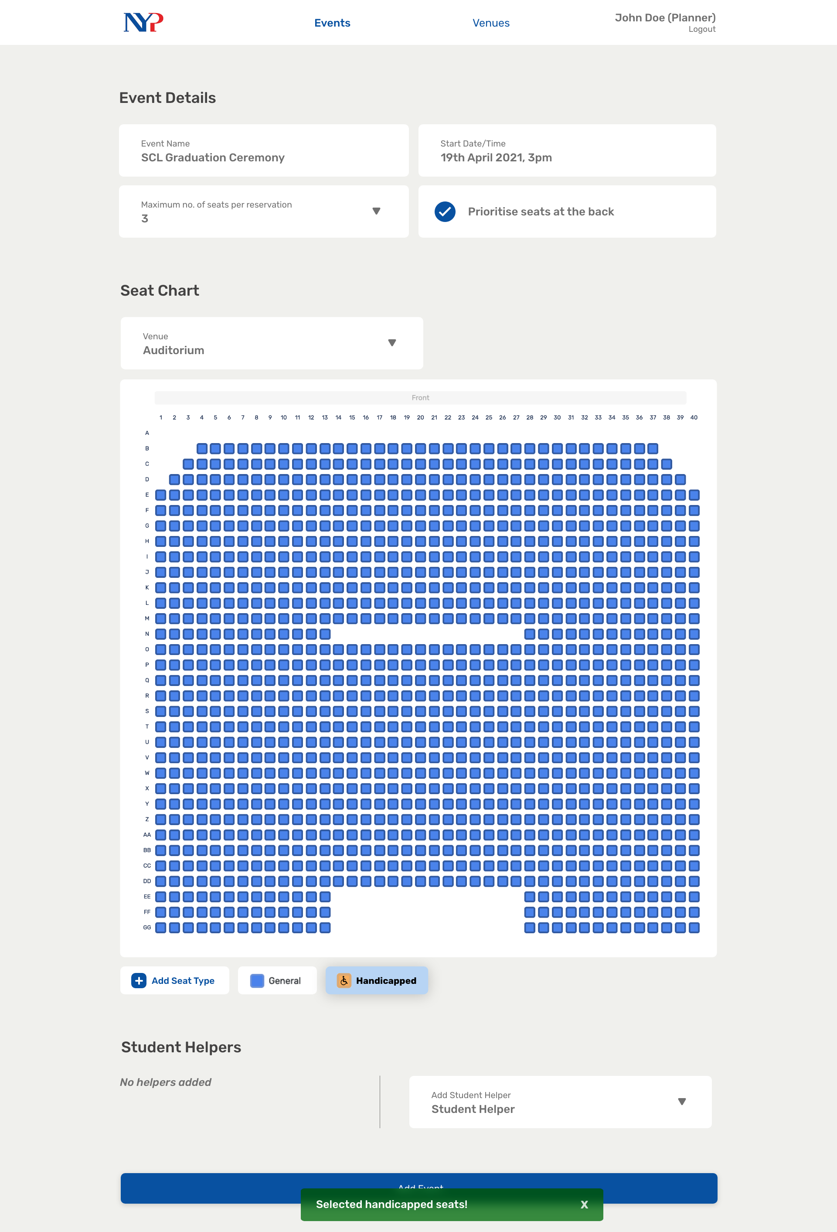
Notes:
35

Slide 40

Notes:
35.5

Slide 41
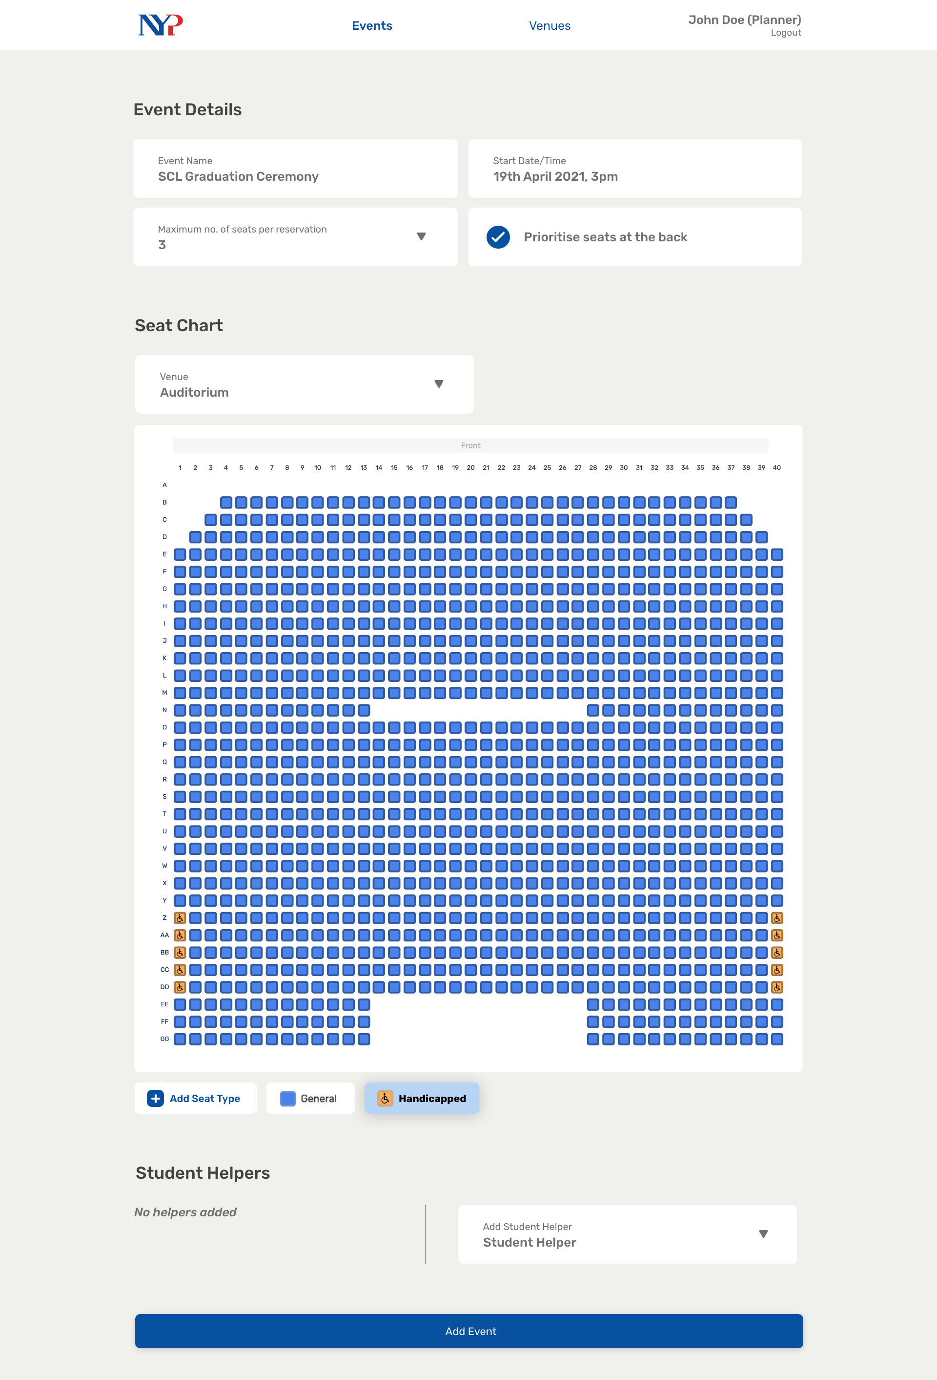
Notes:
36

Slide 42
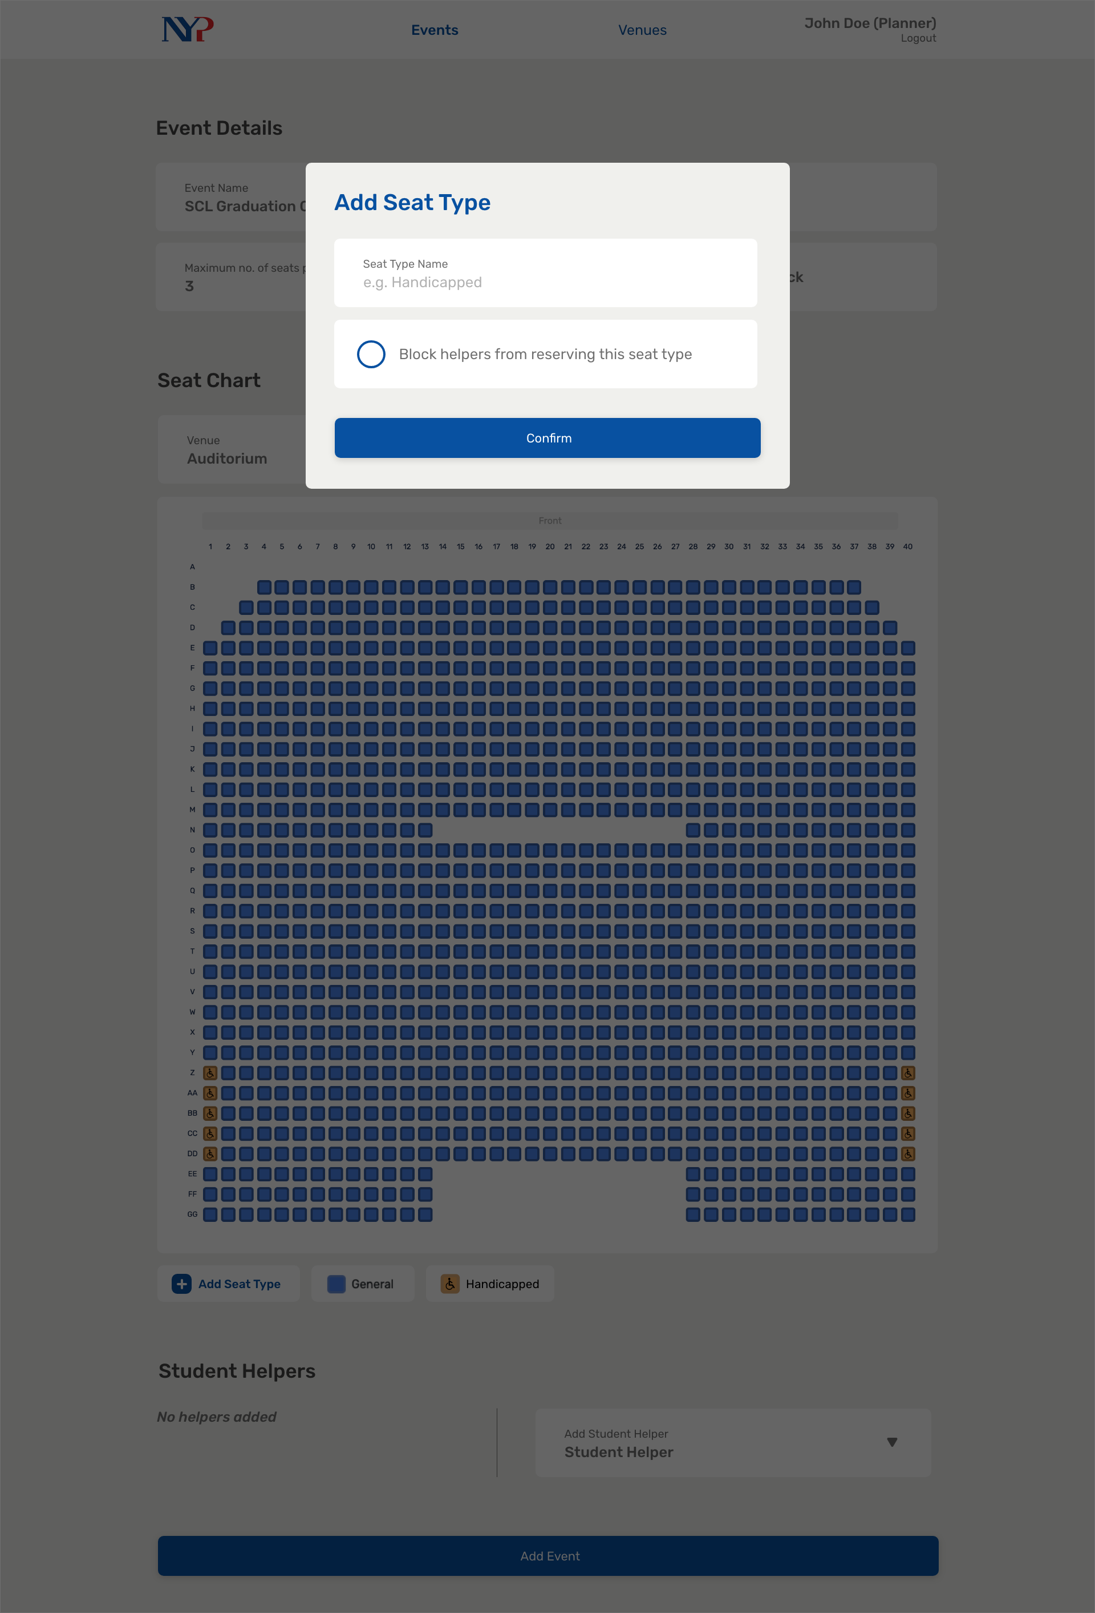
Notes:
37

Slide 43
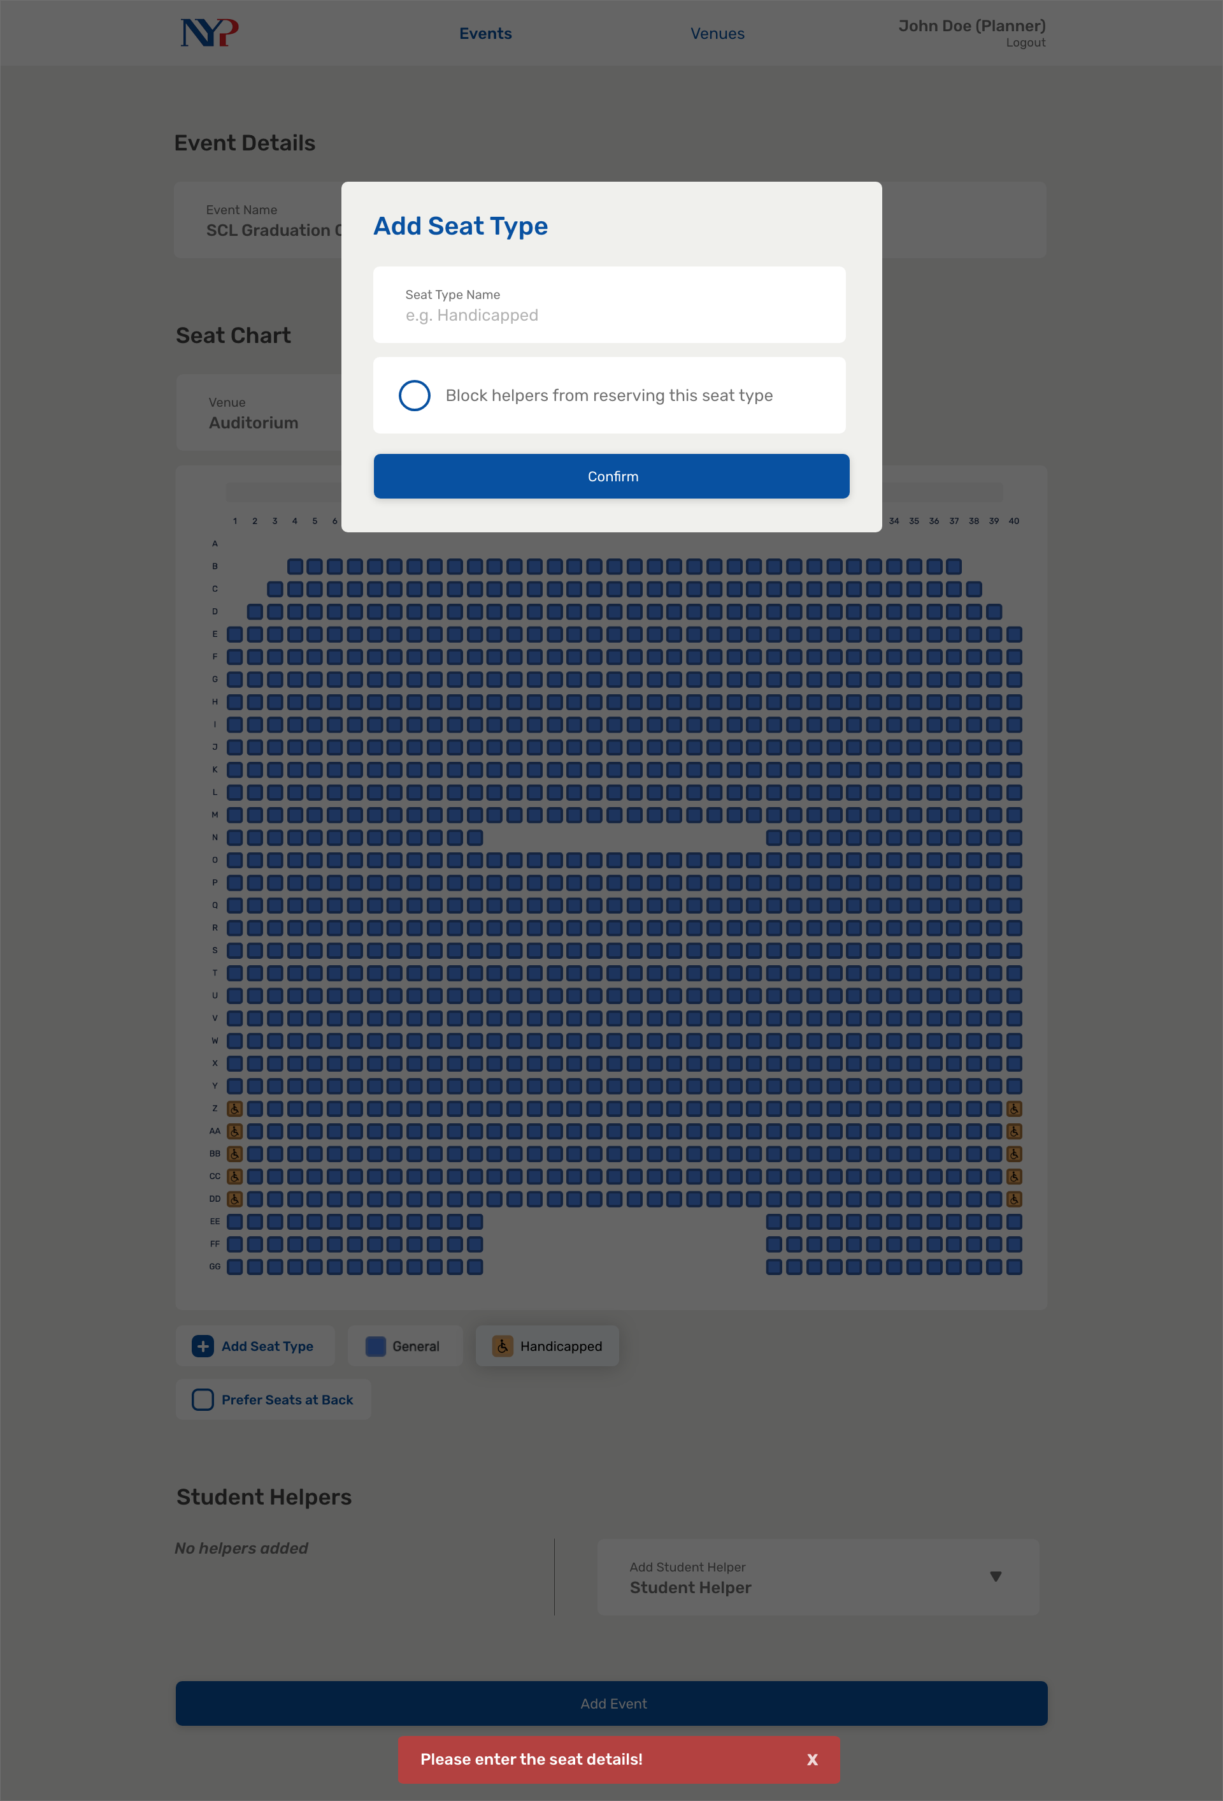
Notes:
38

Slide 44
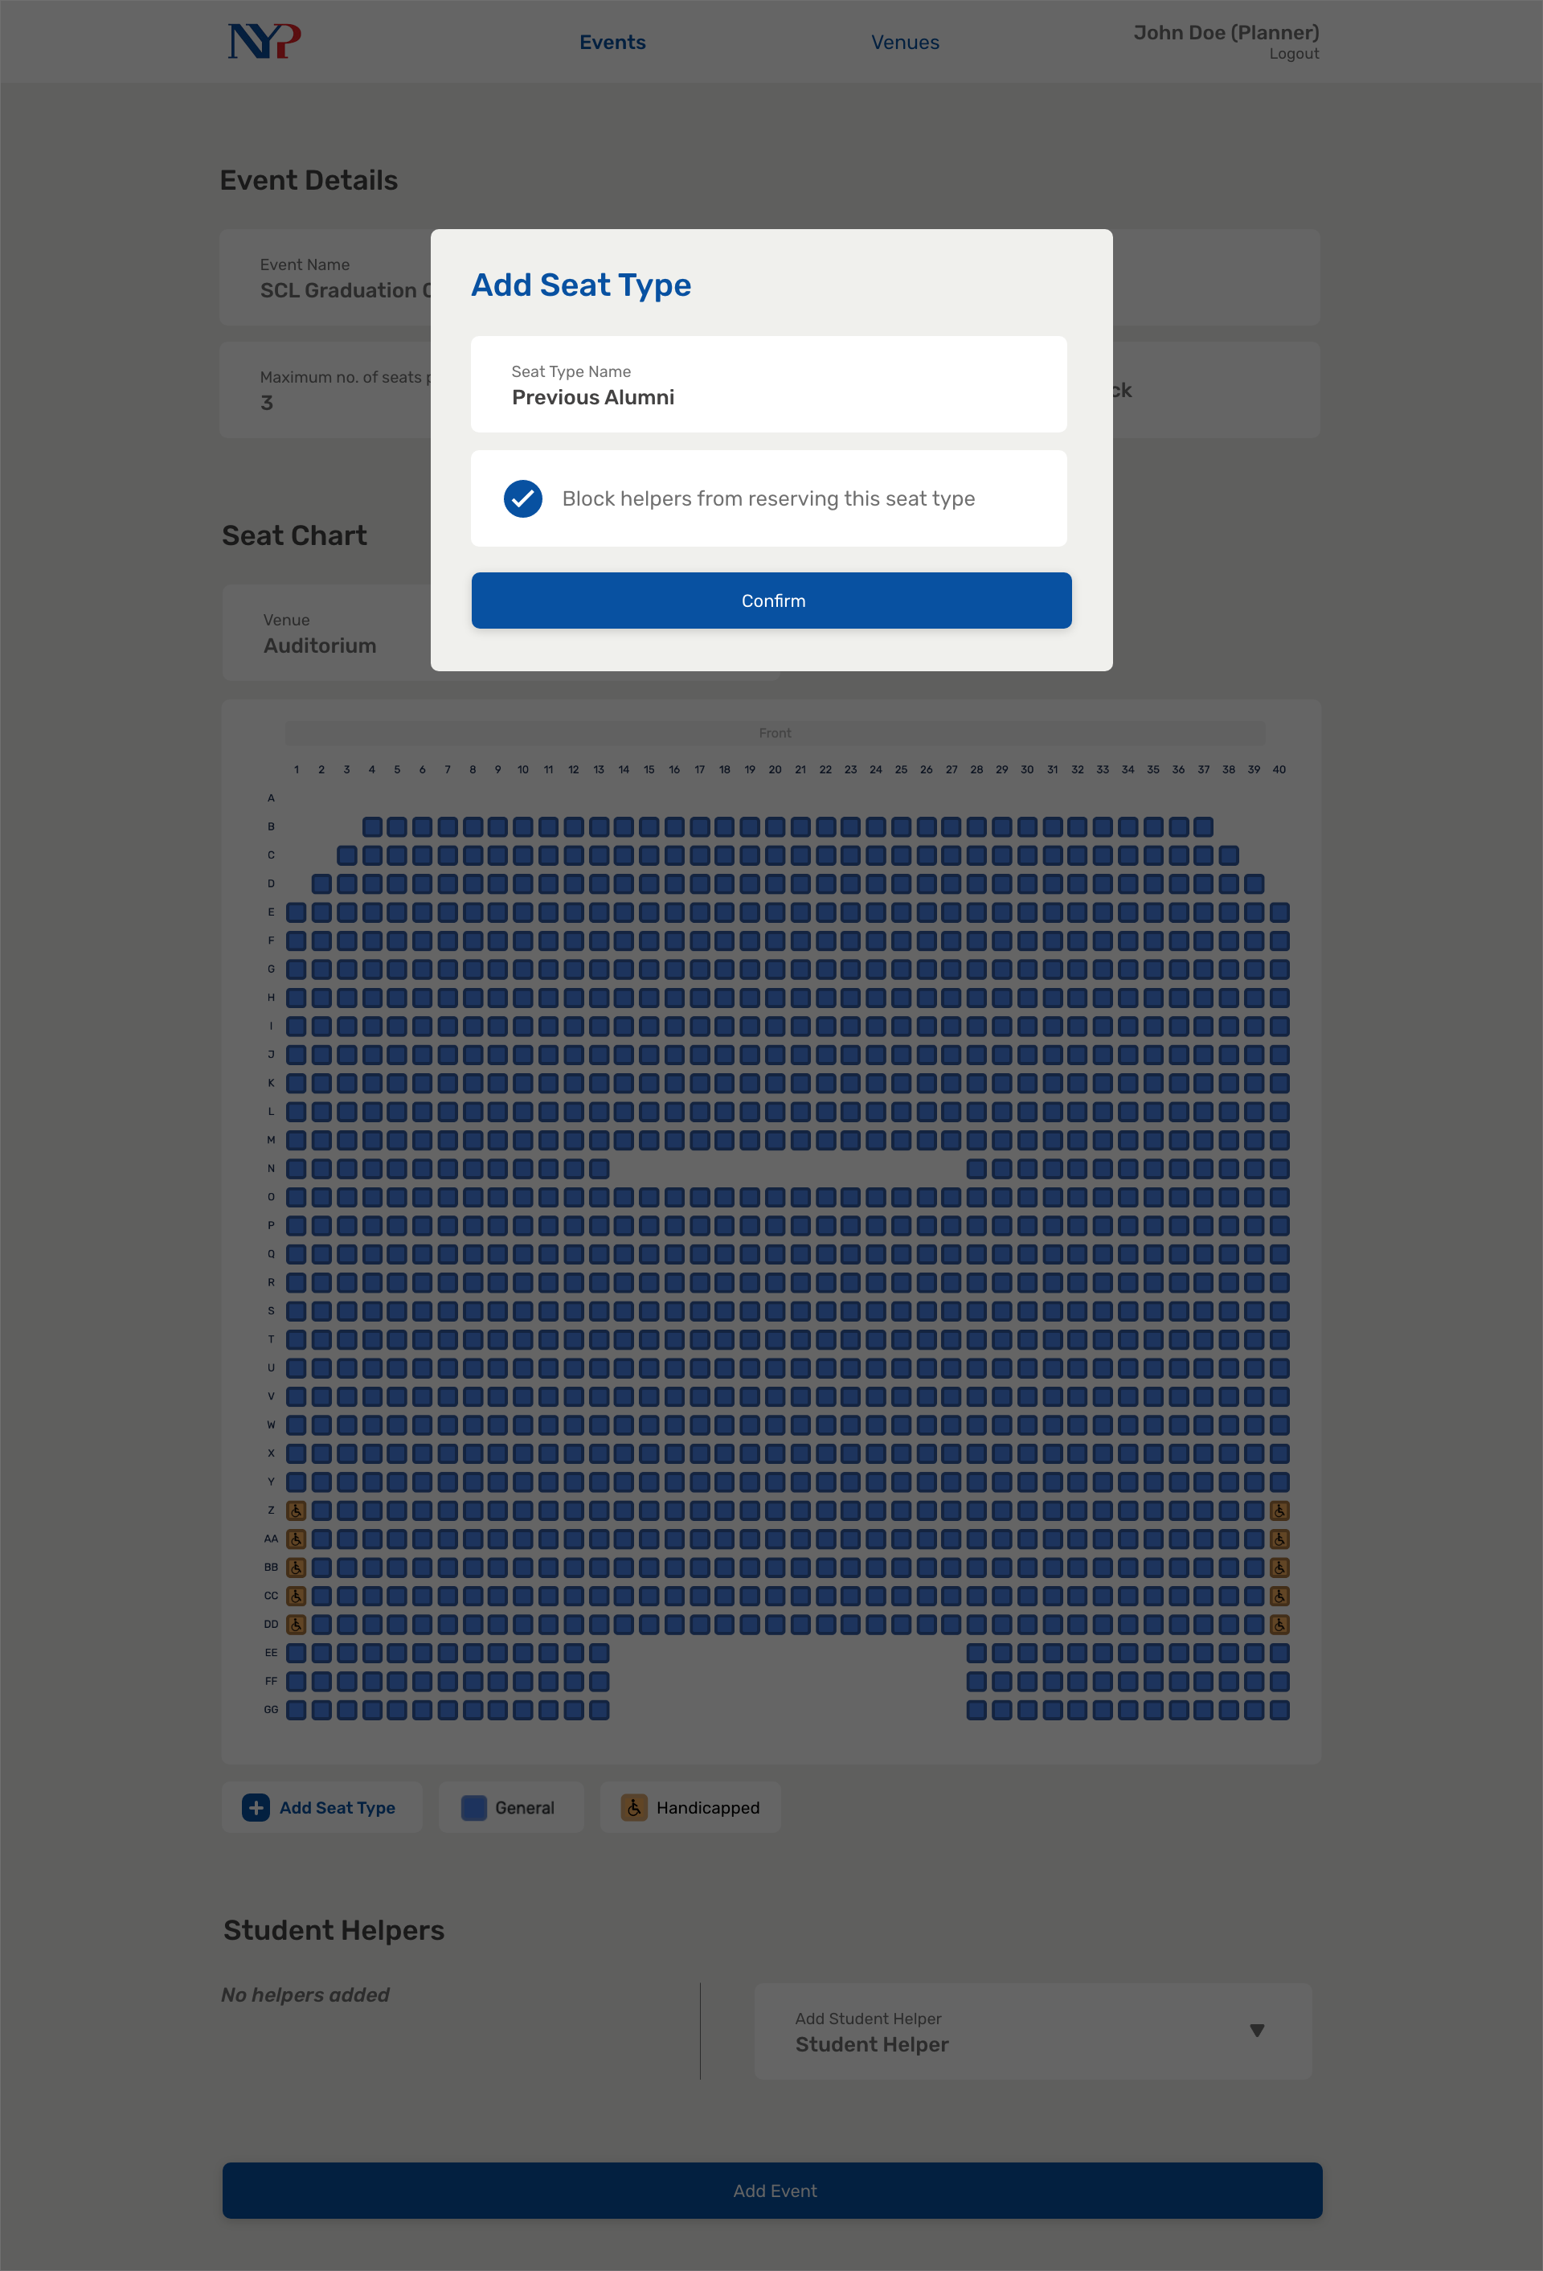
Notes:
39

Slide 45

Notes:
40

Slide 46
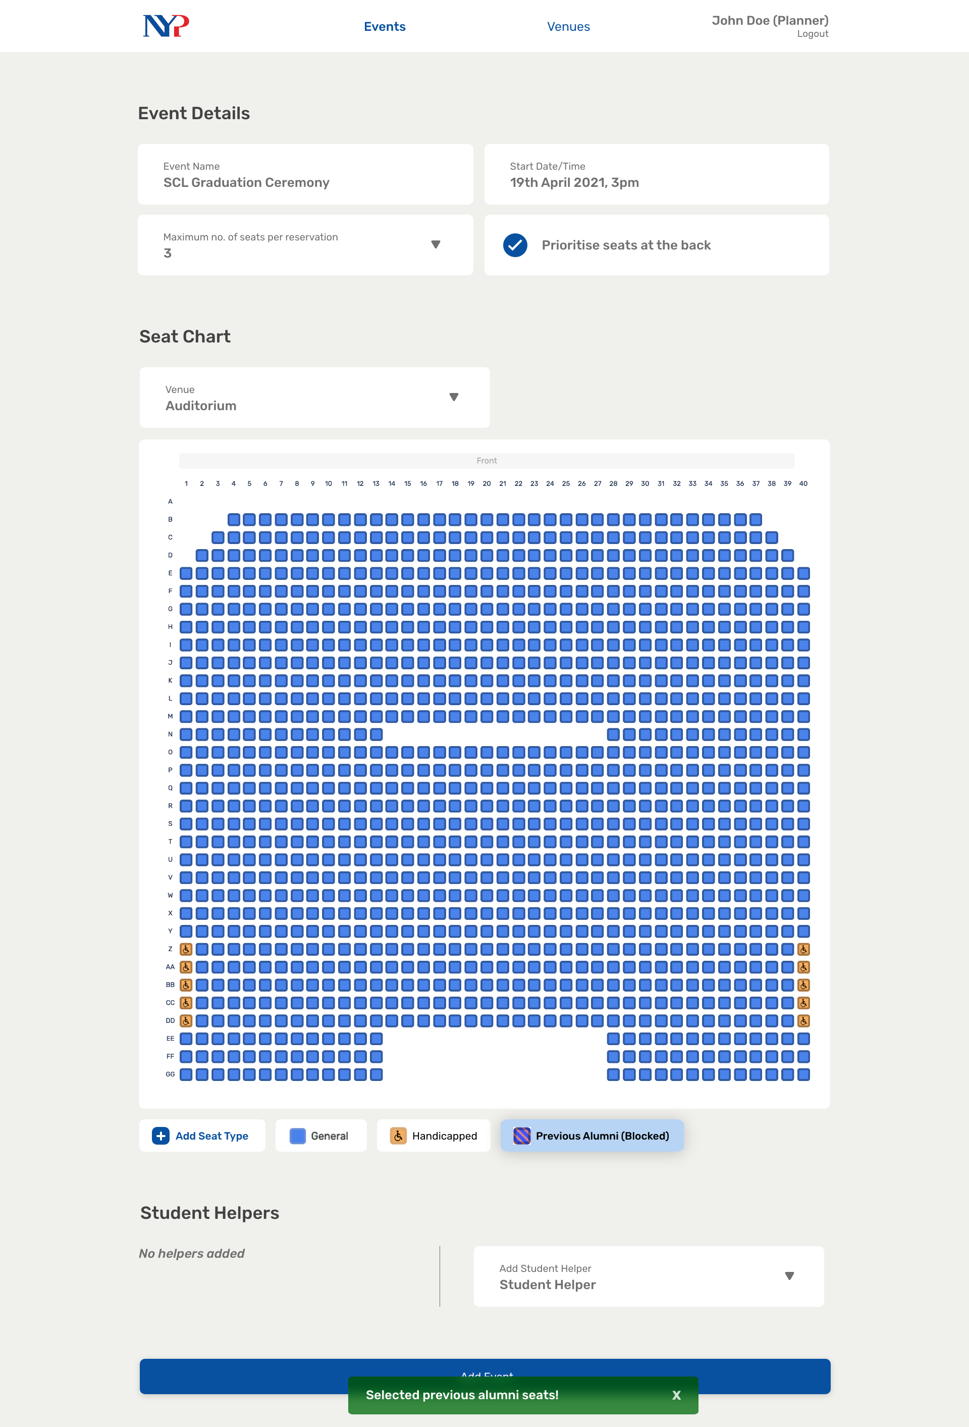
Notes:
41

Slide 47
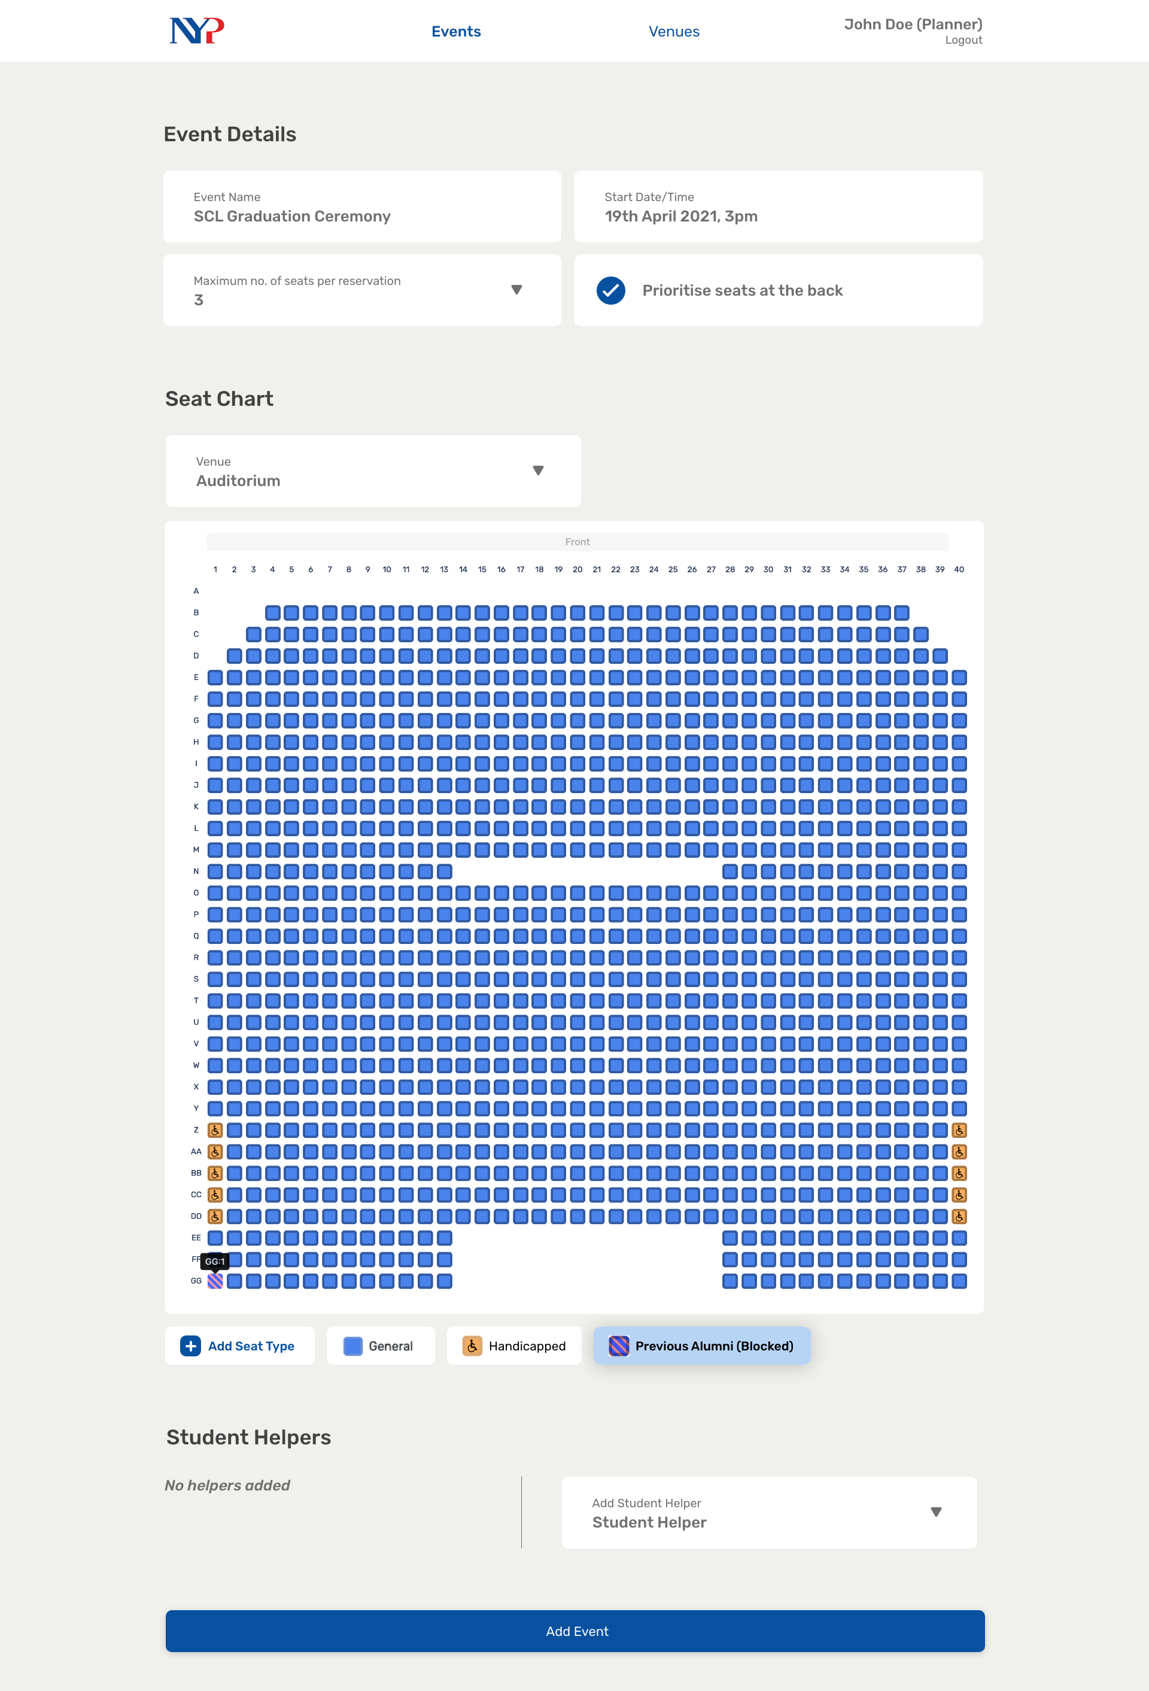
Notes:
41.5

Slide 48
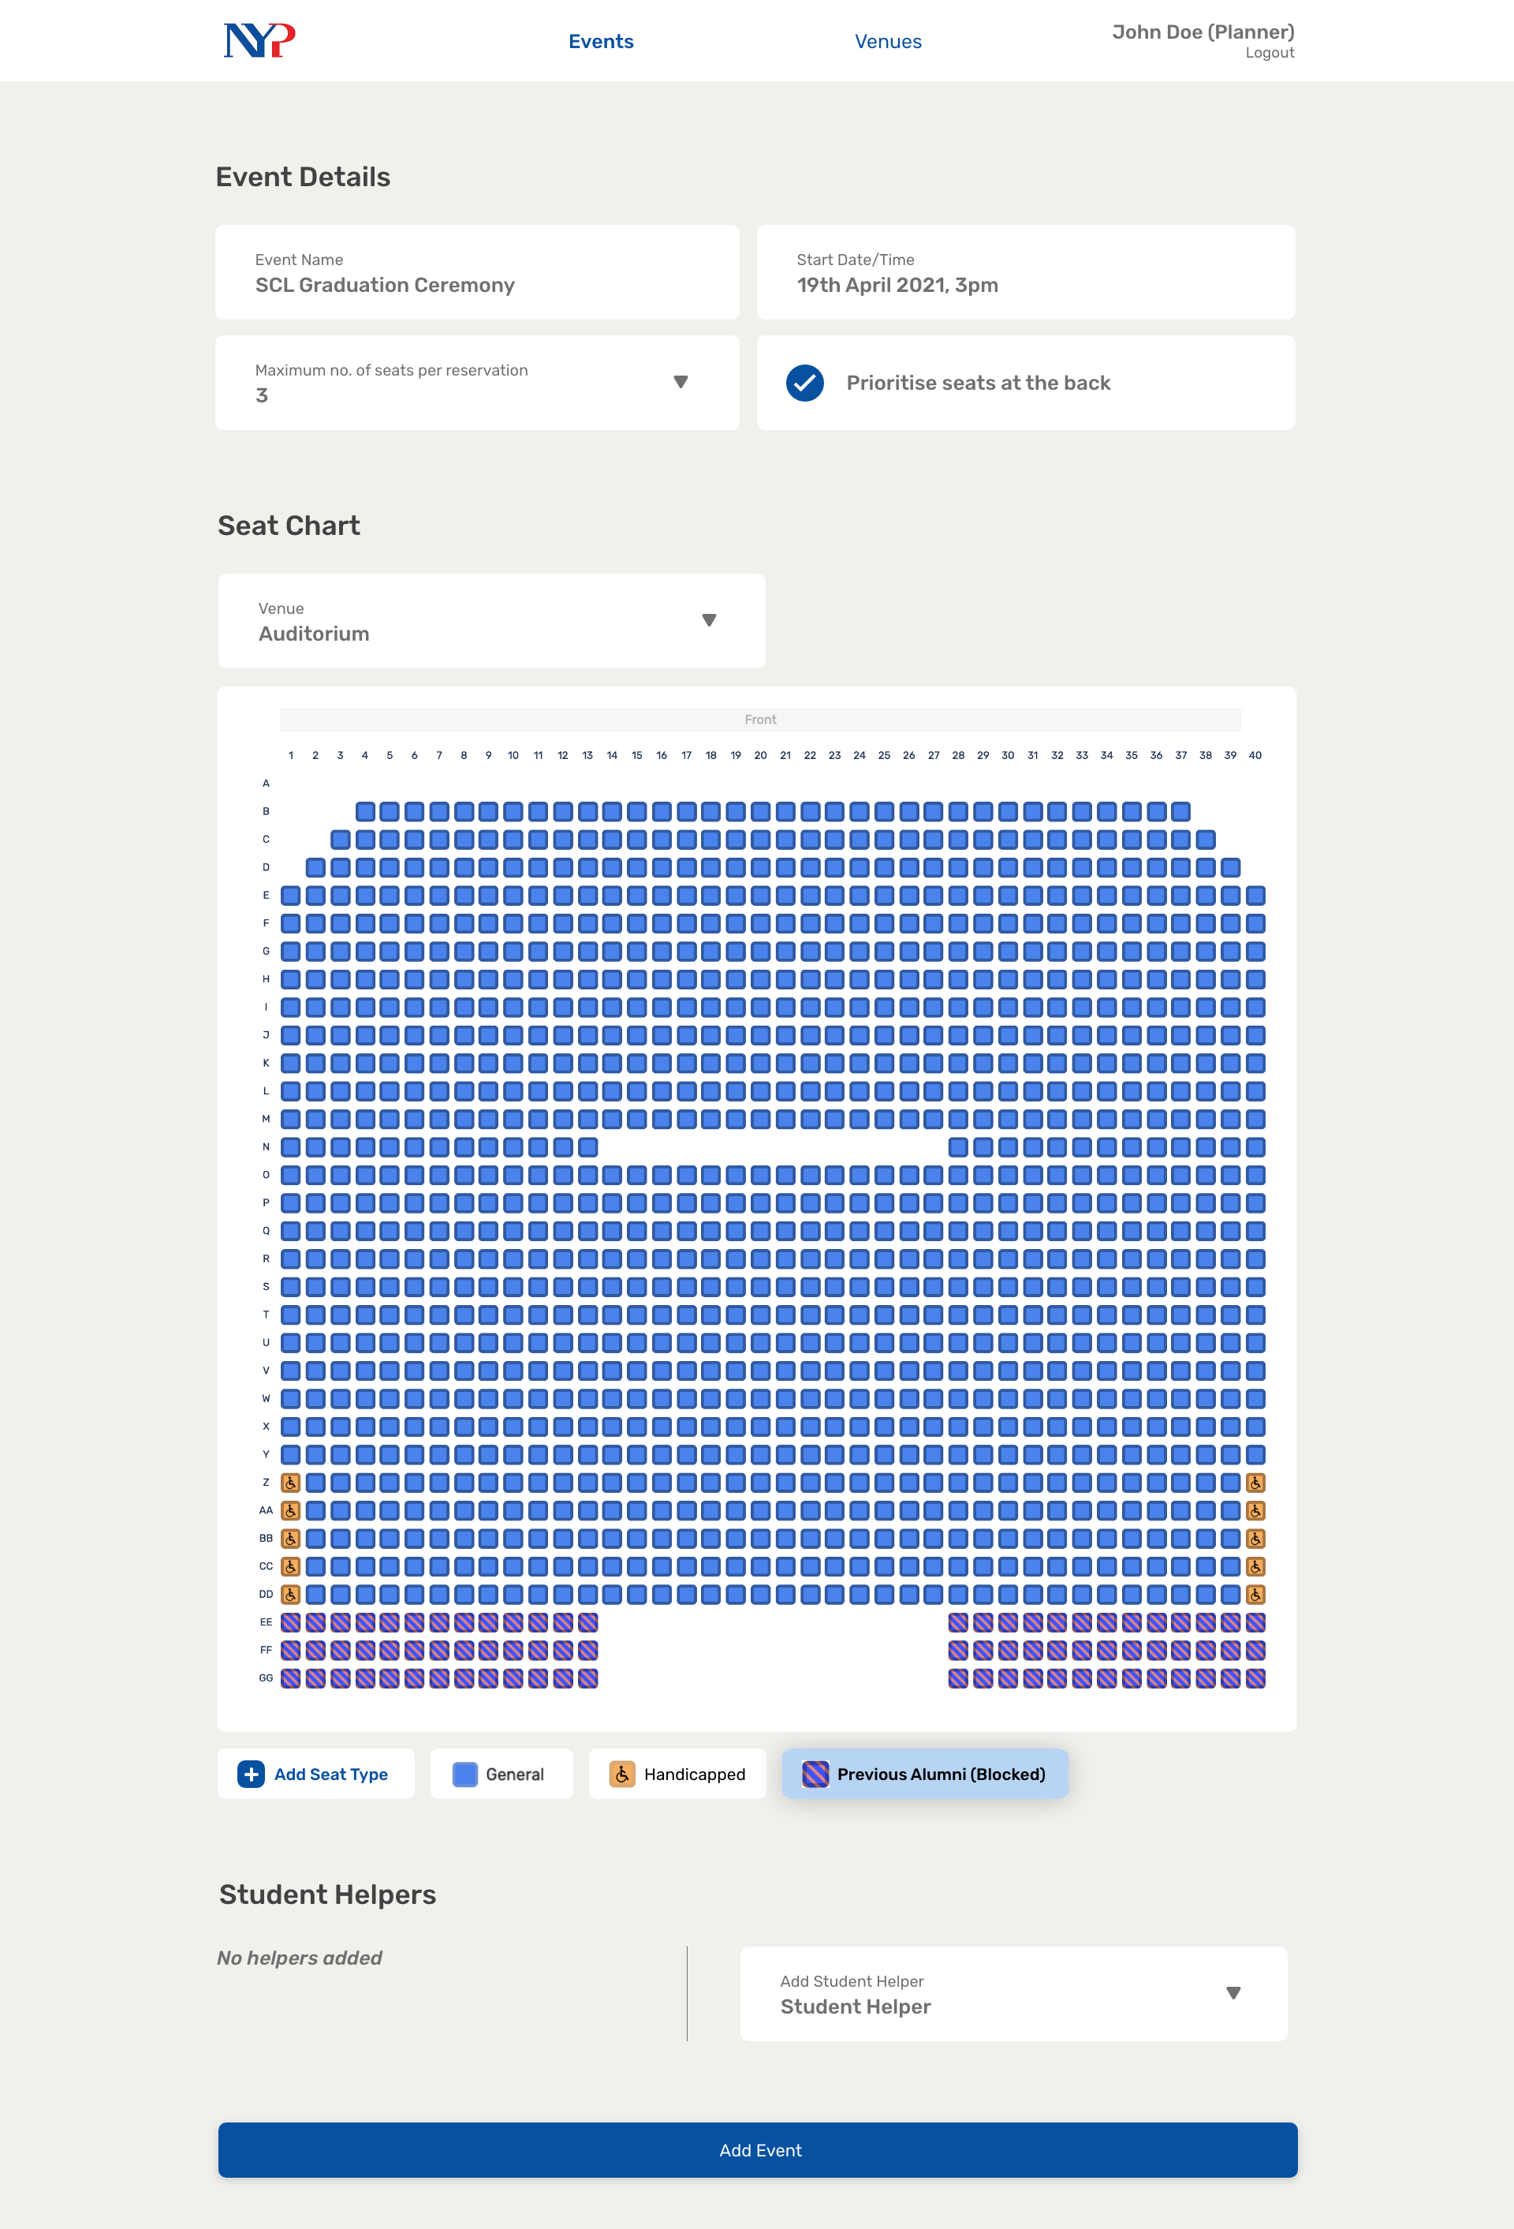
Notes:
42

Slide 49
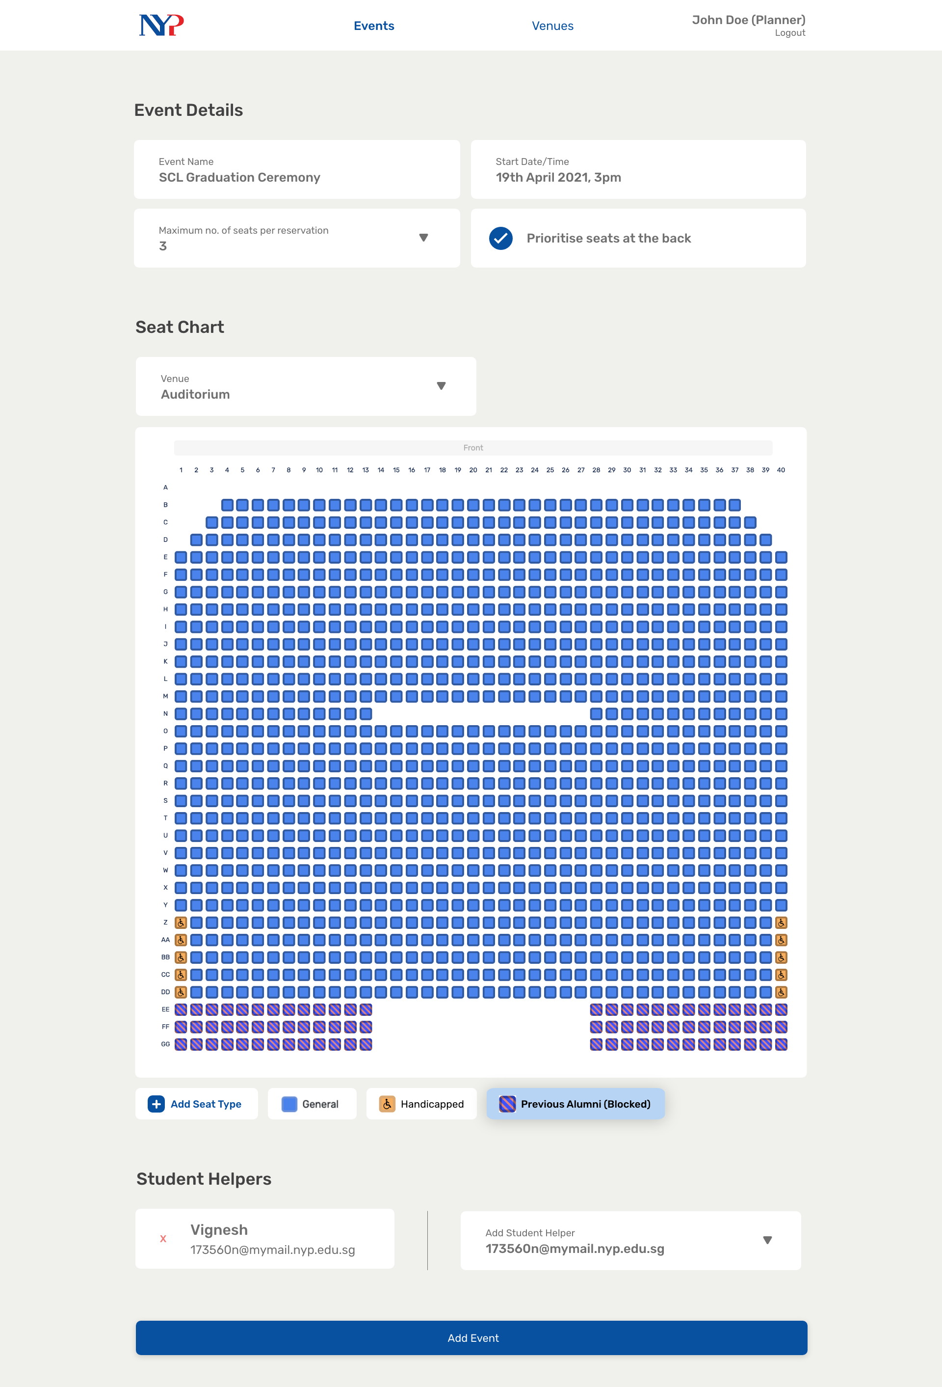
Notes:
43

Slide 50
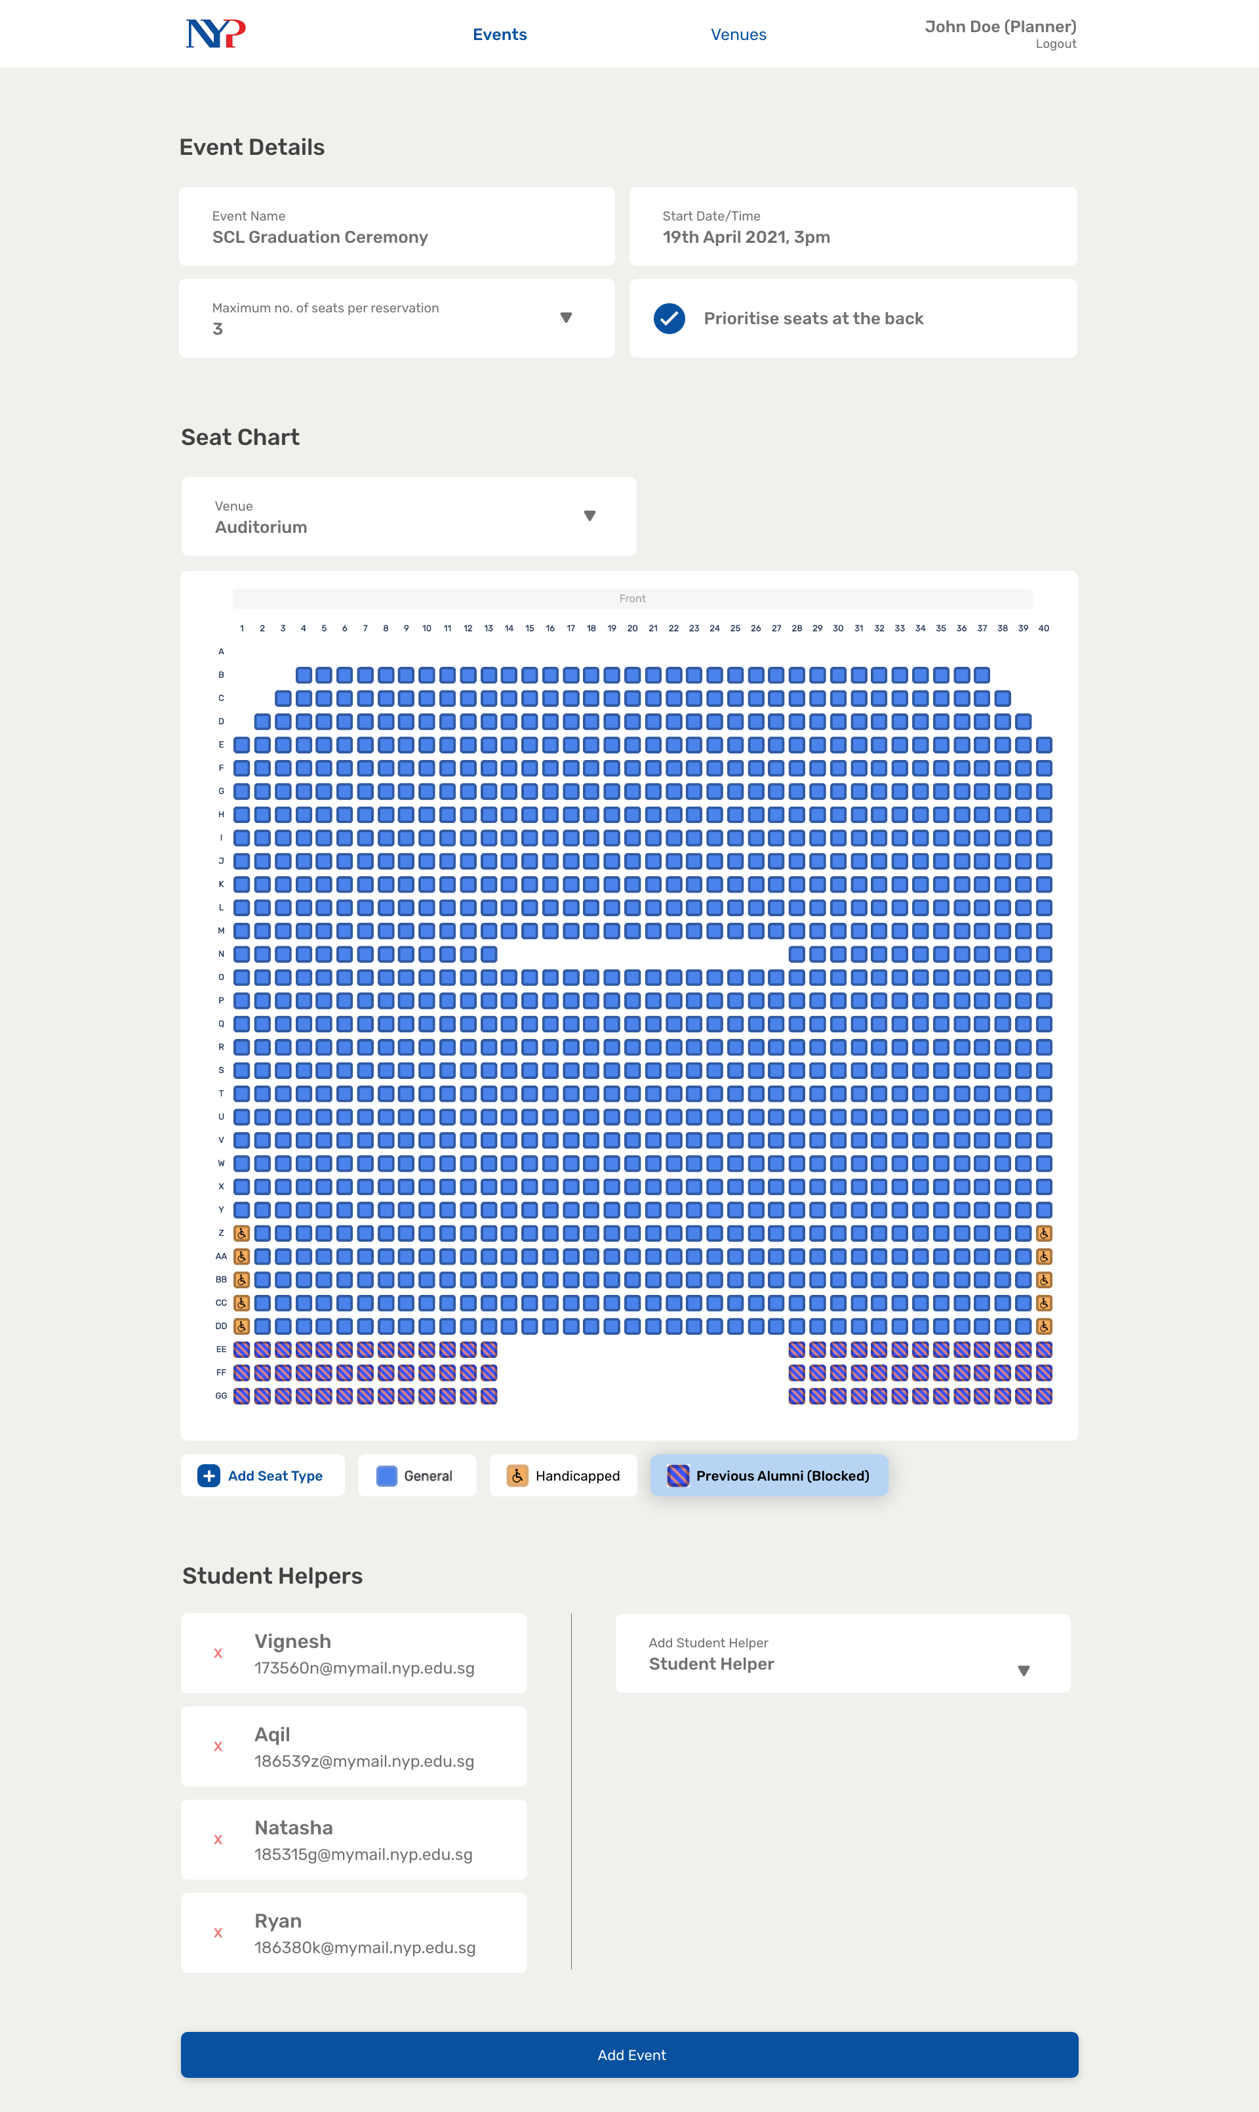
Notes:
43.5

Slide 51
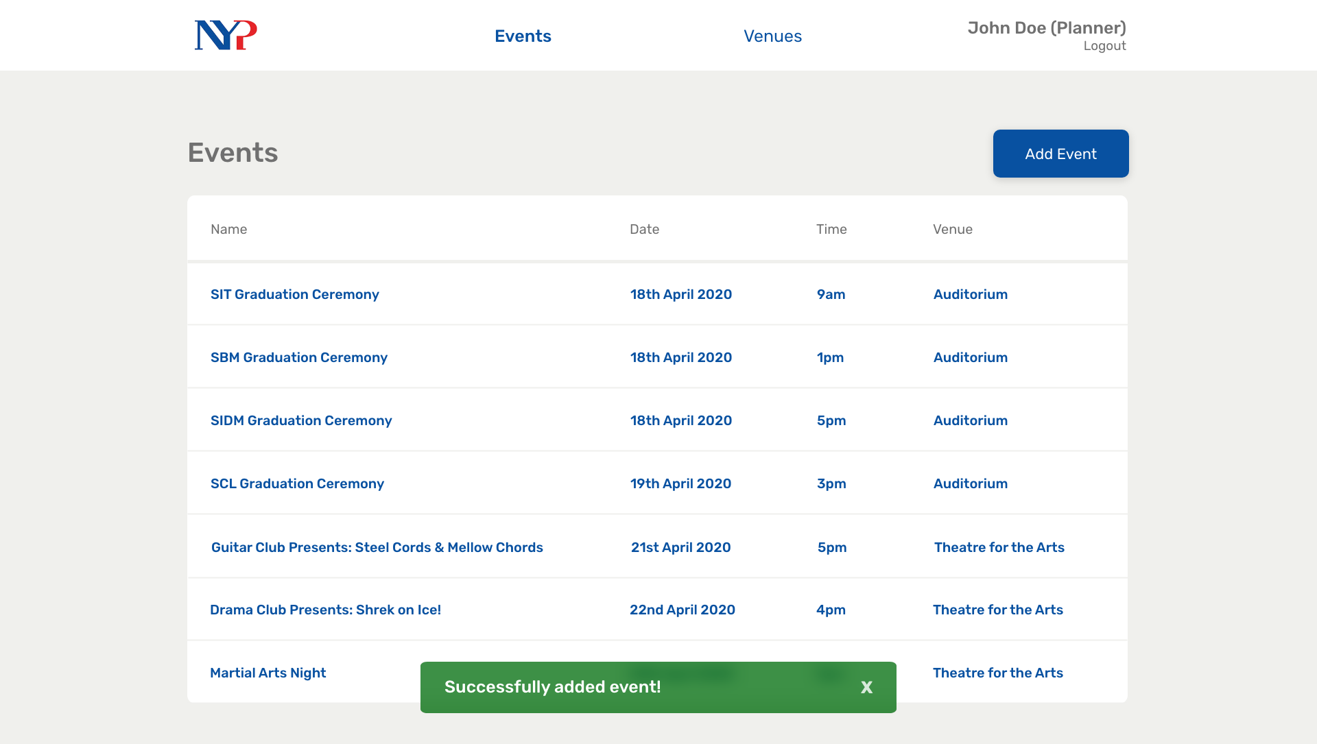
Notes:
44

Slide 52
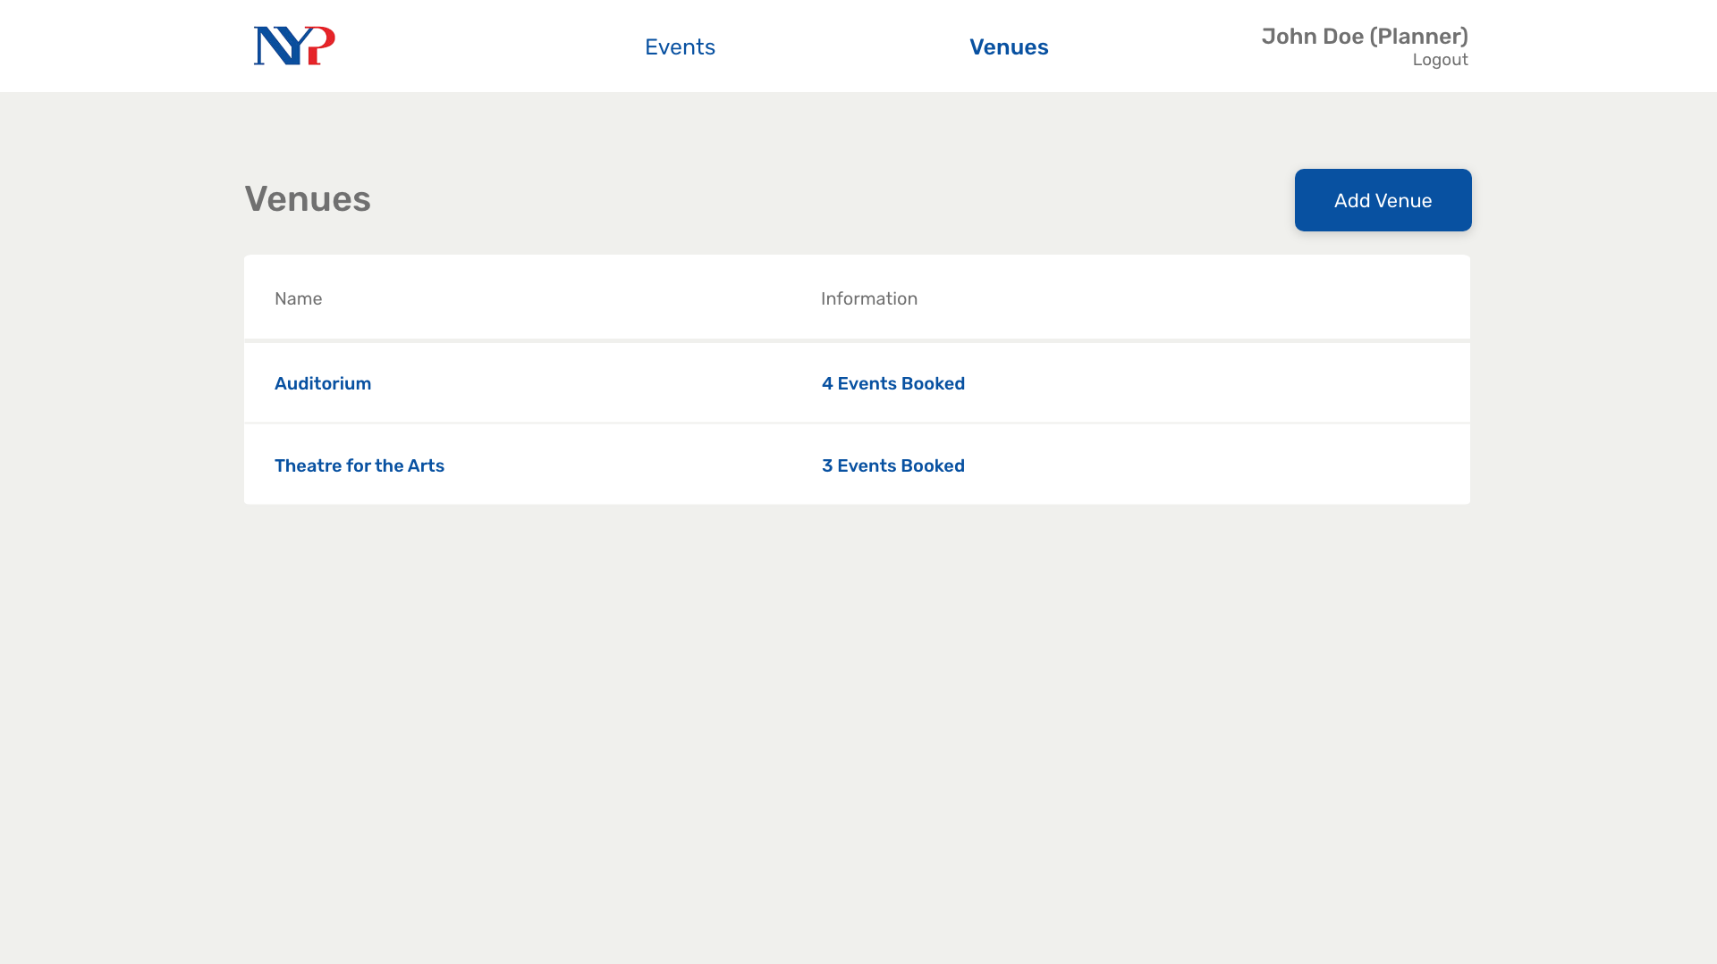
Notes:
46

Slide 53
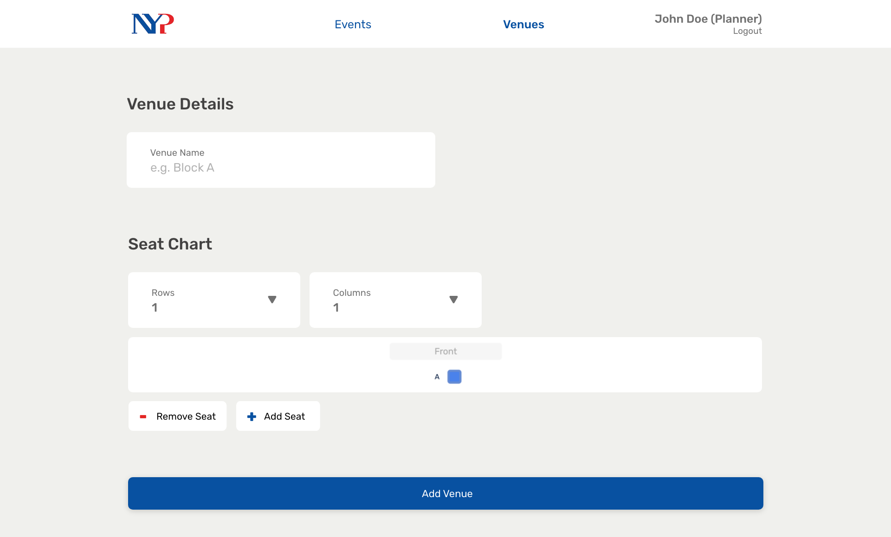
Notes:
47

Slide 54
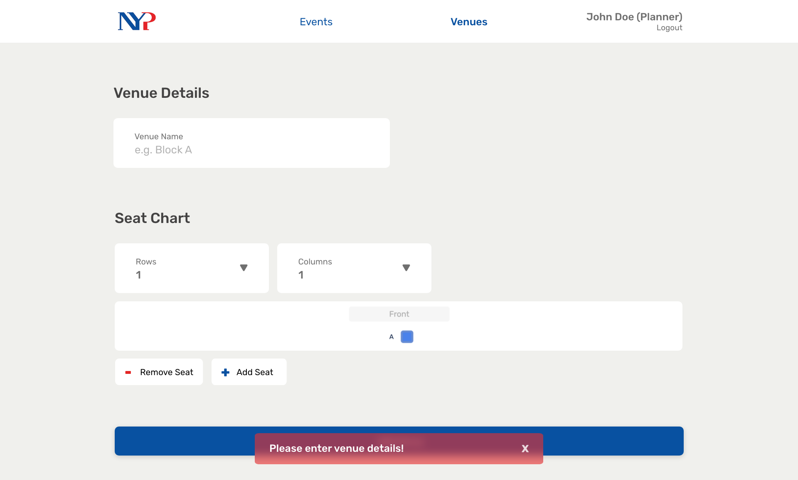
Notes:
48

Slide 55
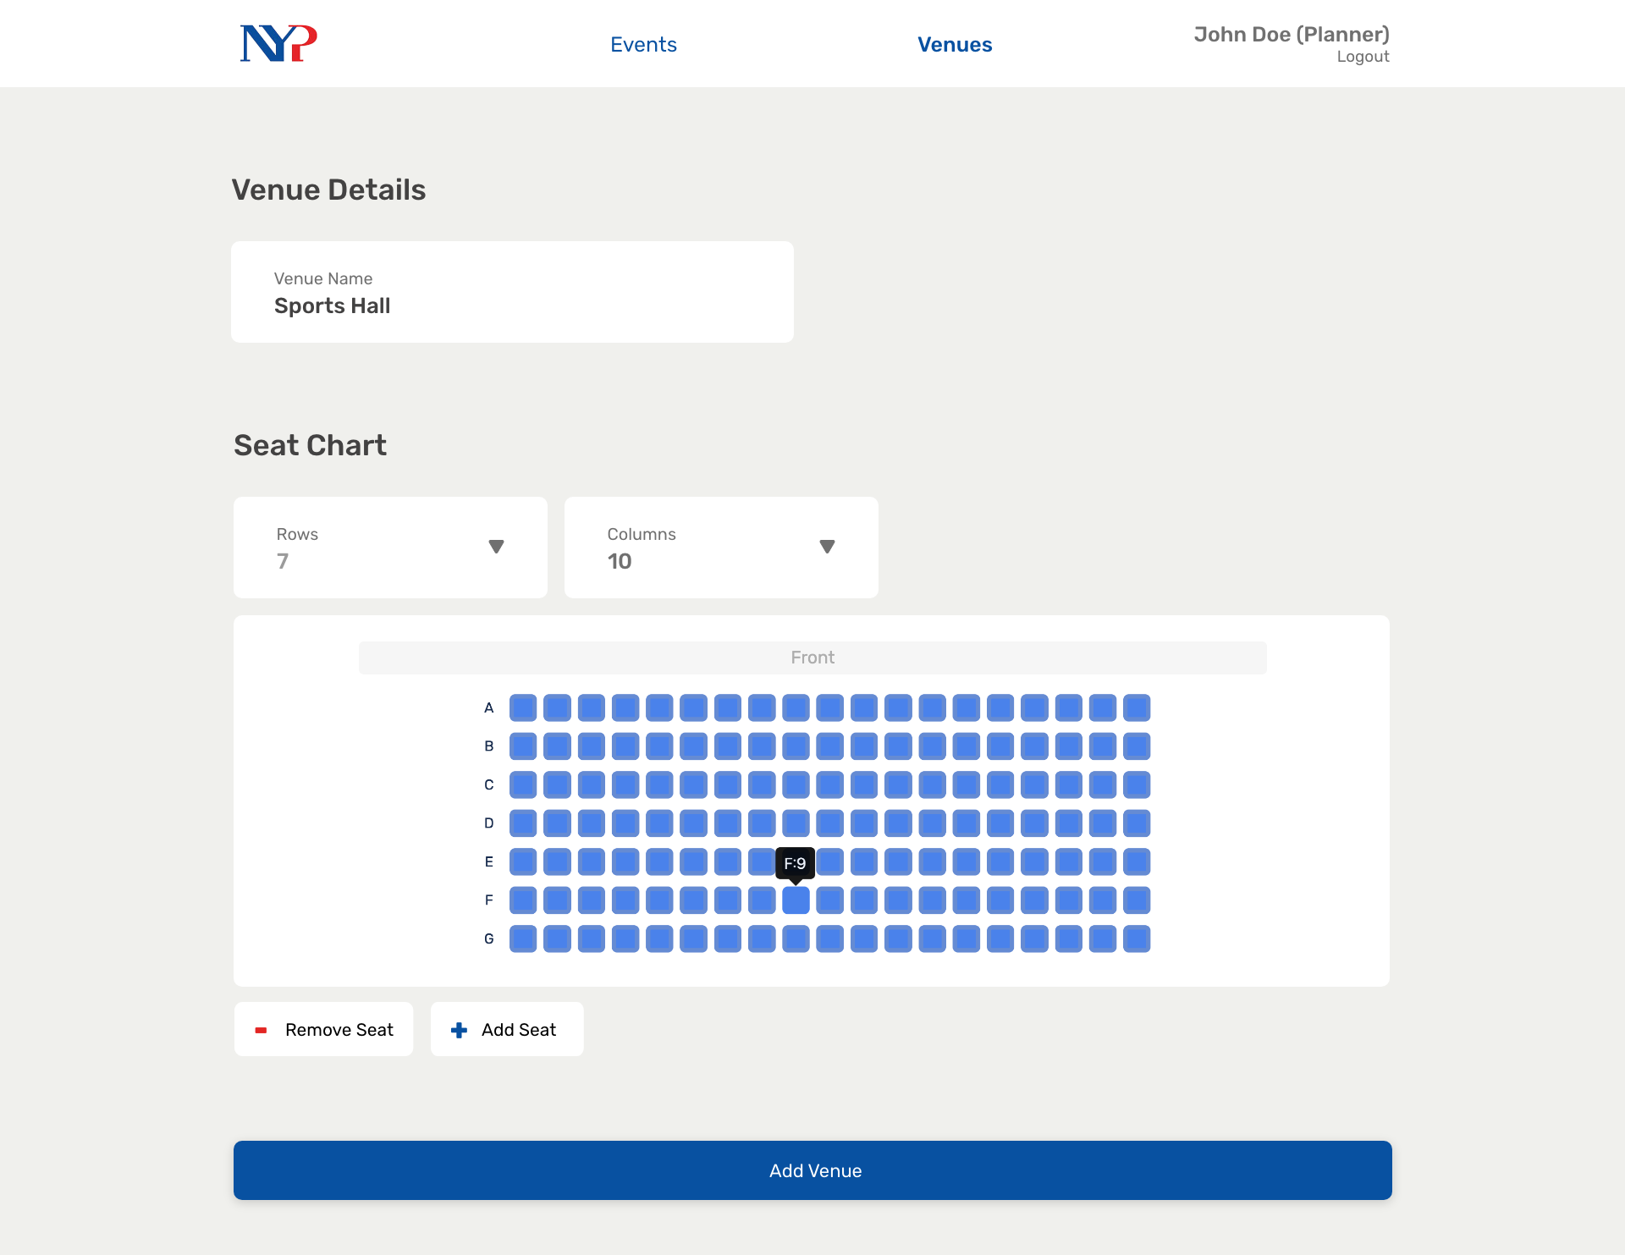
Notes:
49

Slide 56
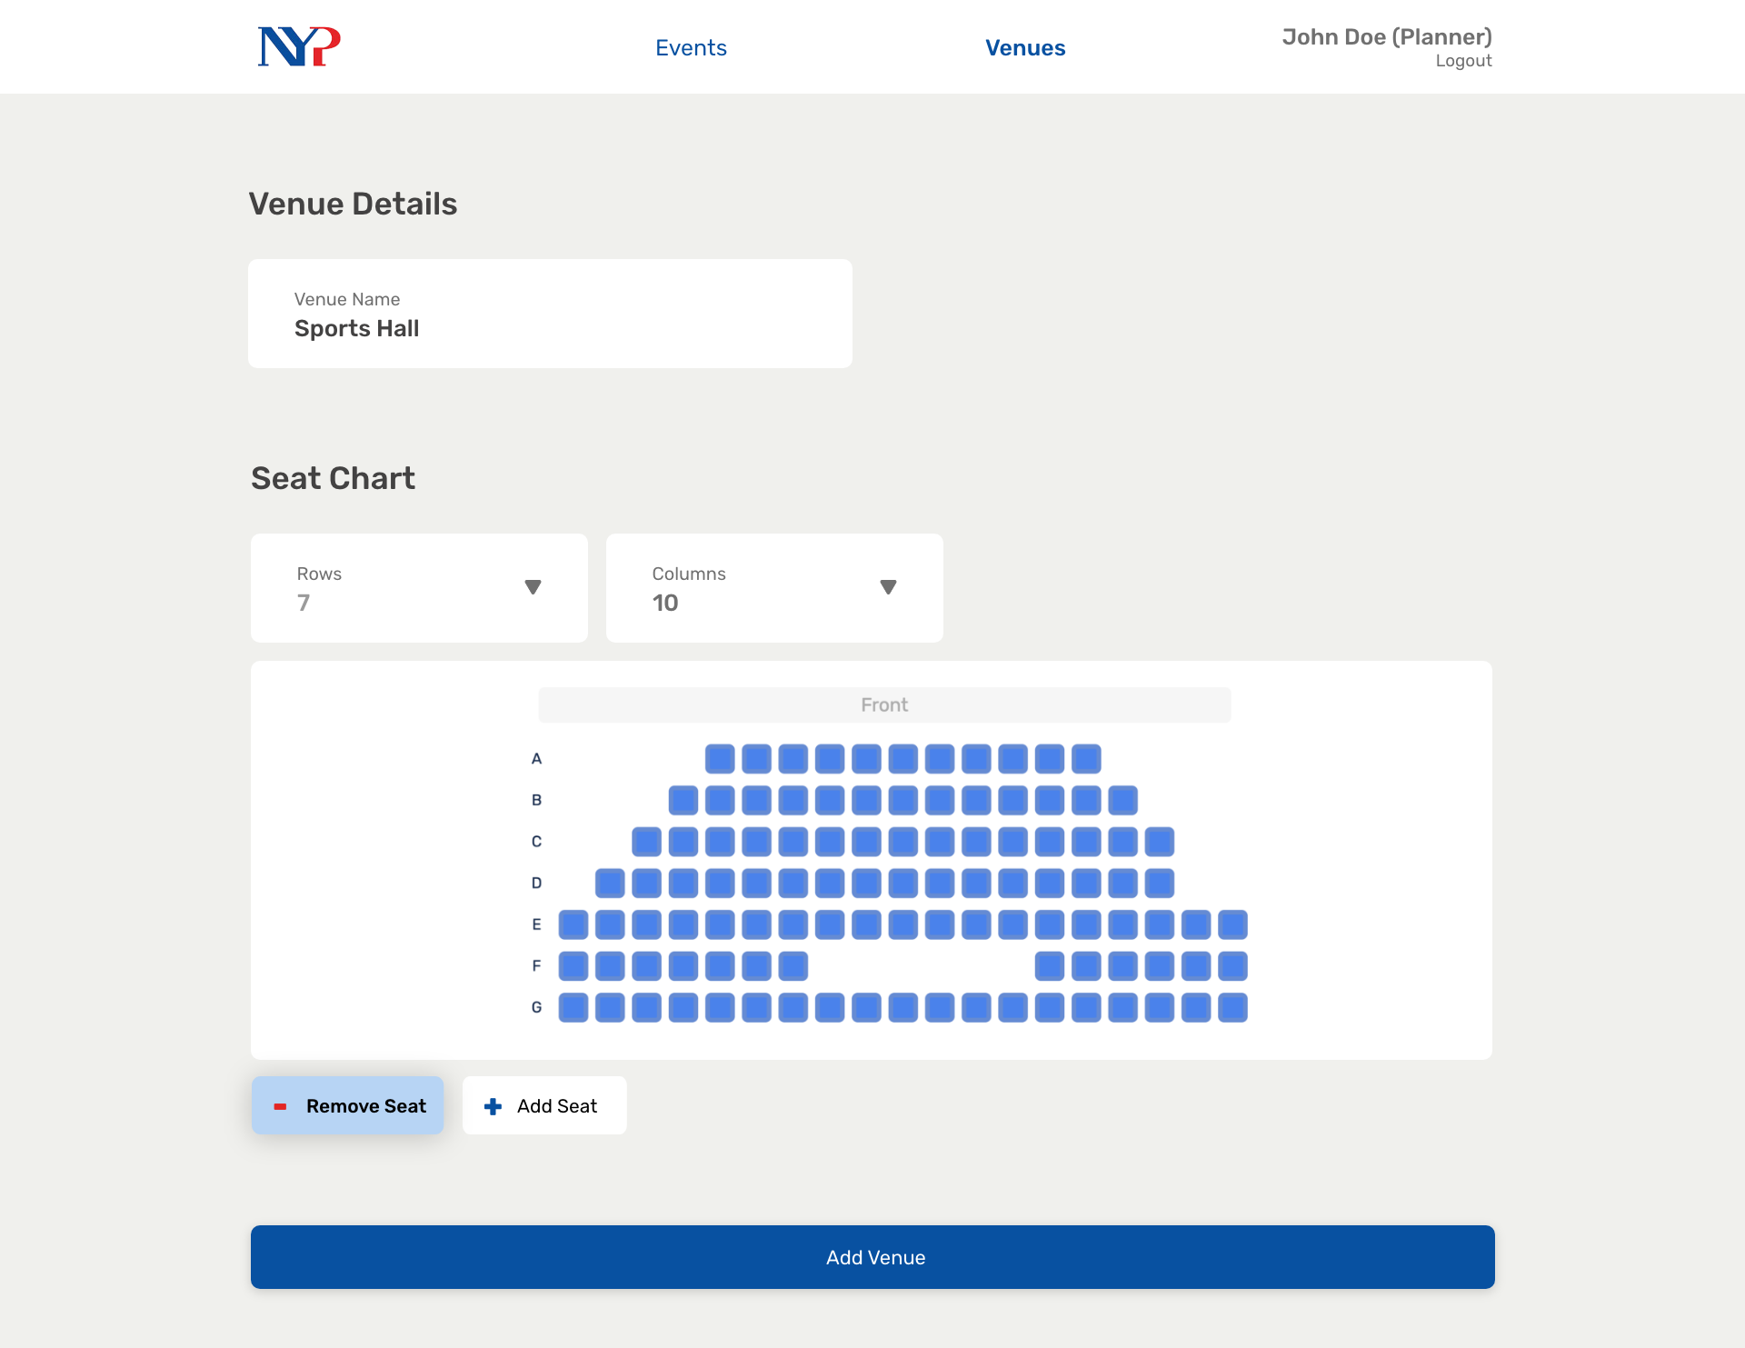
Notes:
50

Slide 57
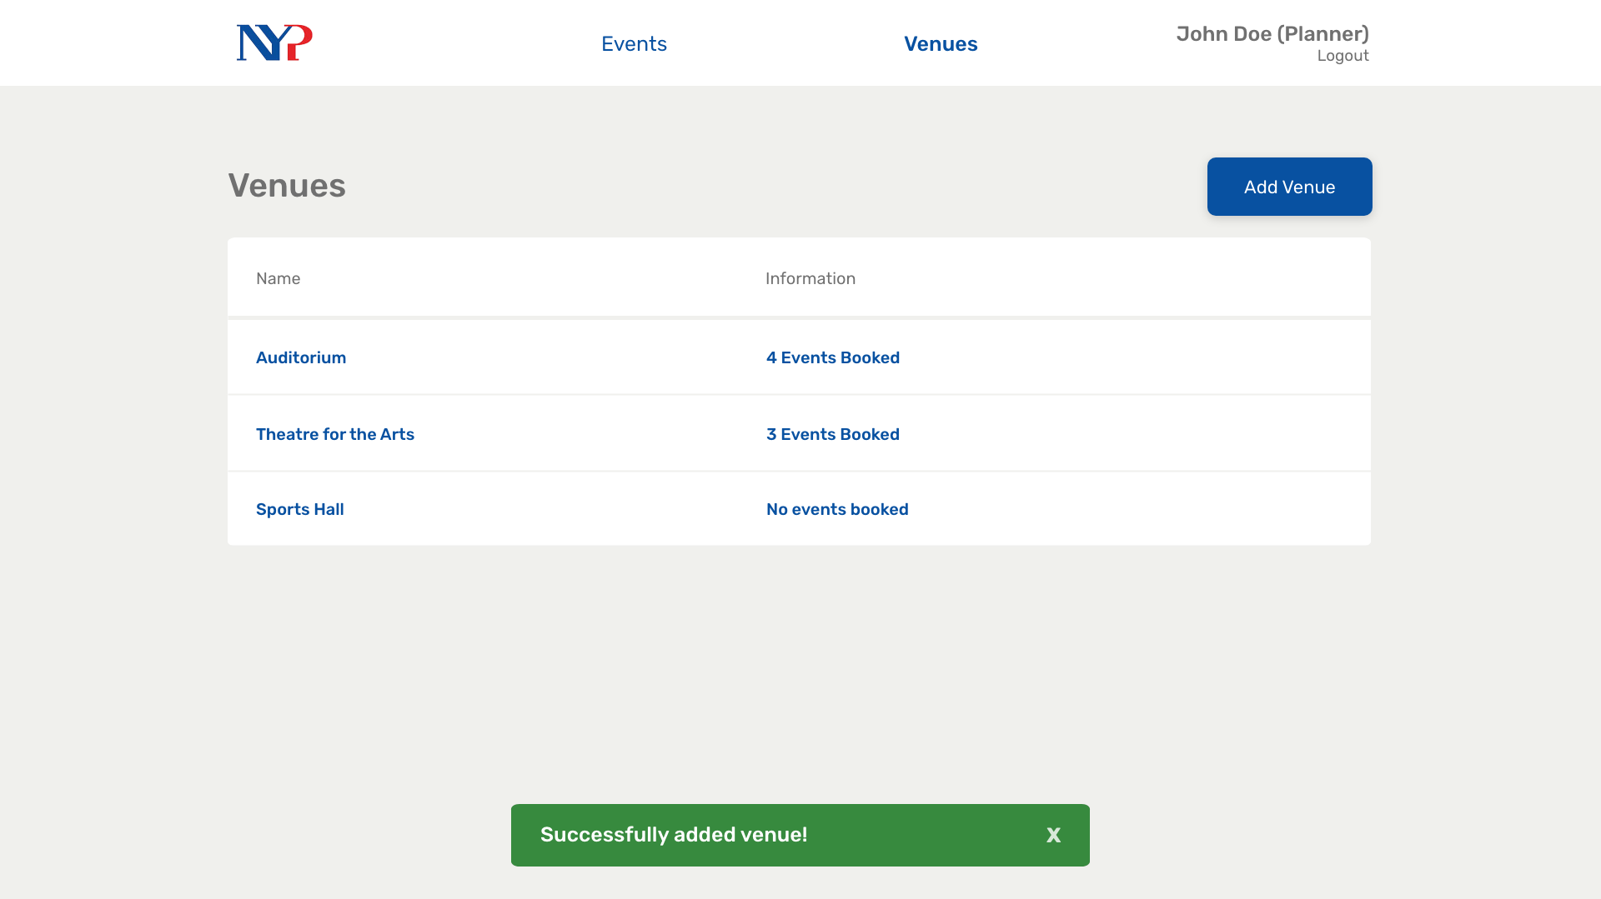
Notes:
51

Slide 58
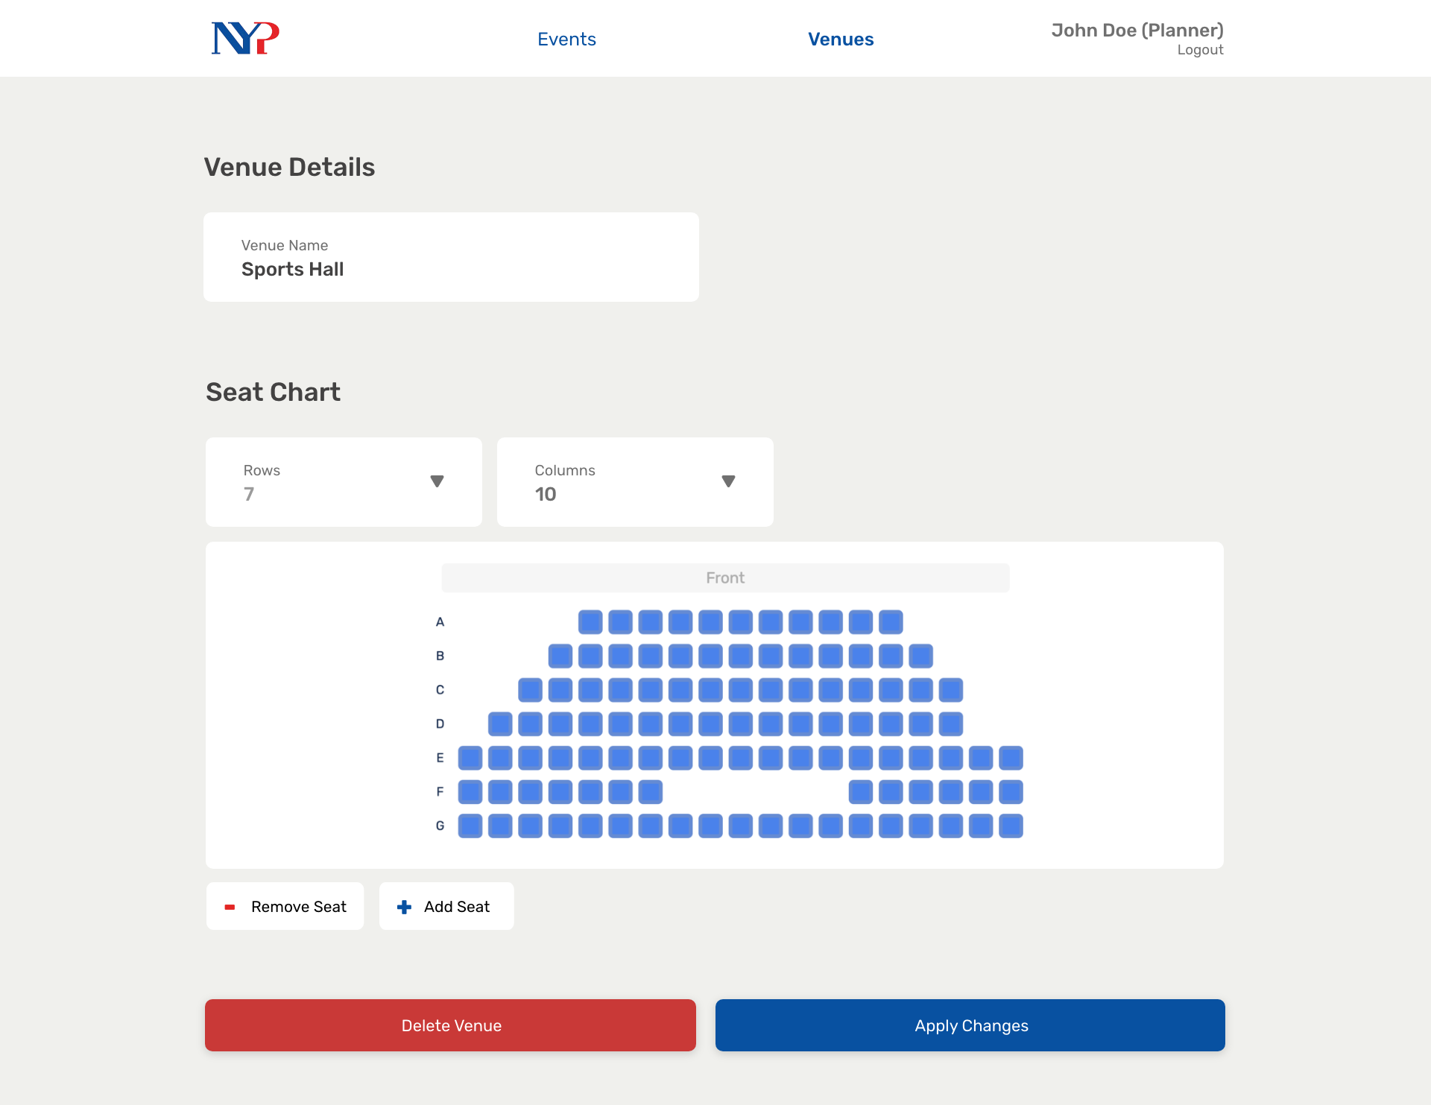
Notes:
52

Slide 59

Notes:
53 Admin

Slide 60
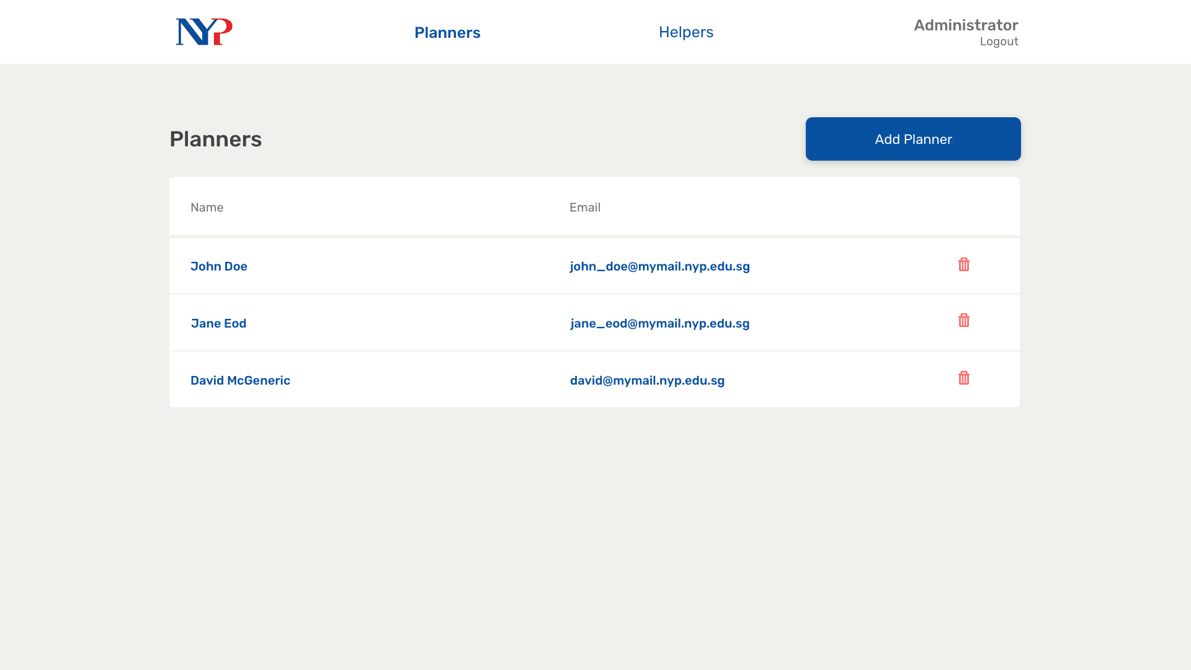
Notes:
54

Slide 61
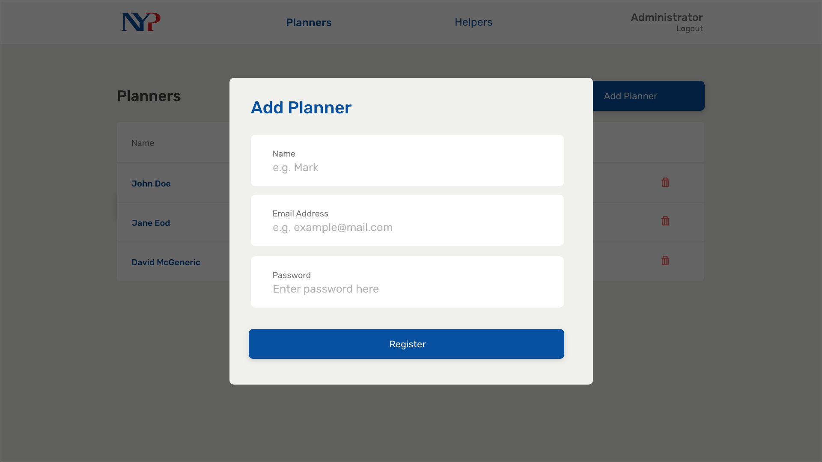
Notes:
55

Slide 62
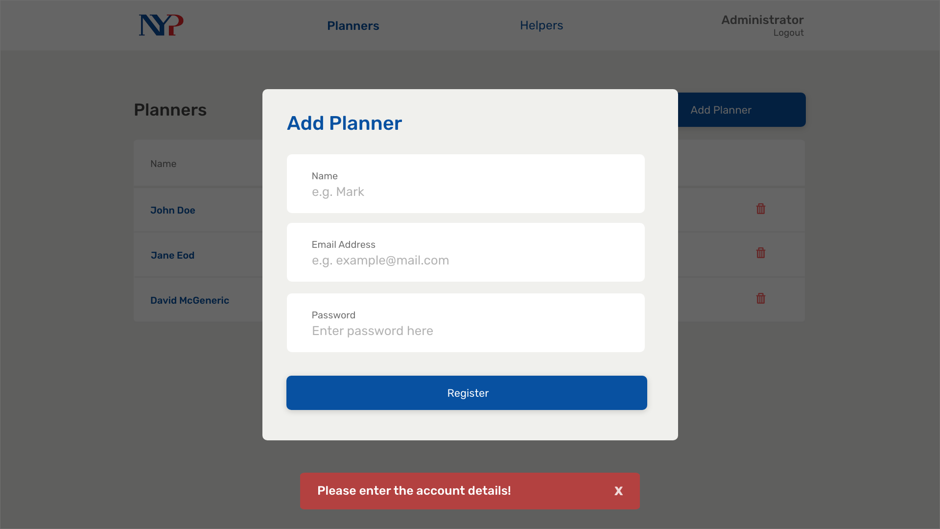
Notes:
56

Slide 63

Notes:
57

Slide 64
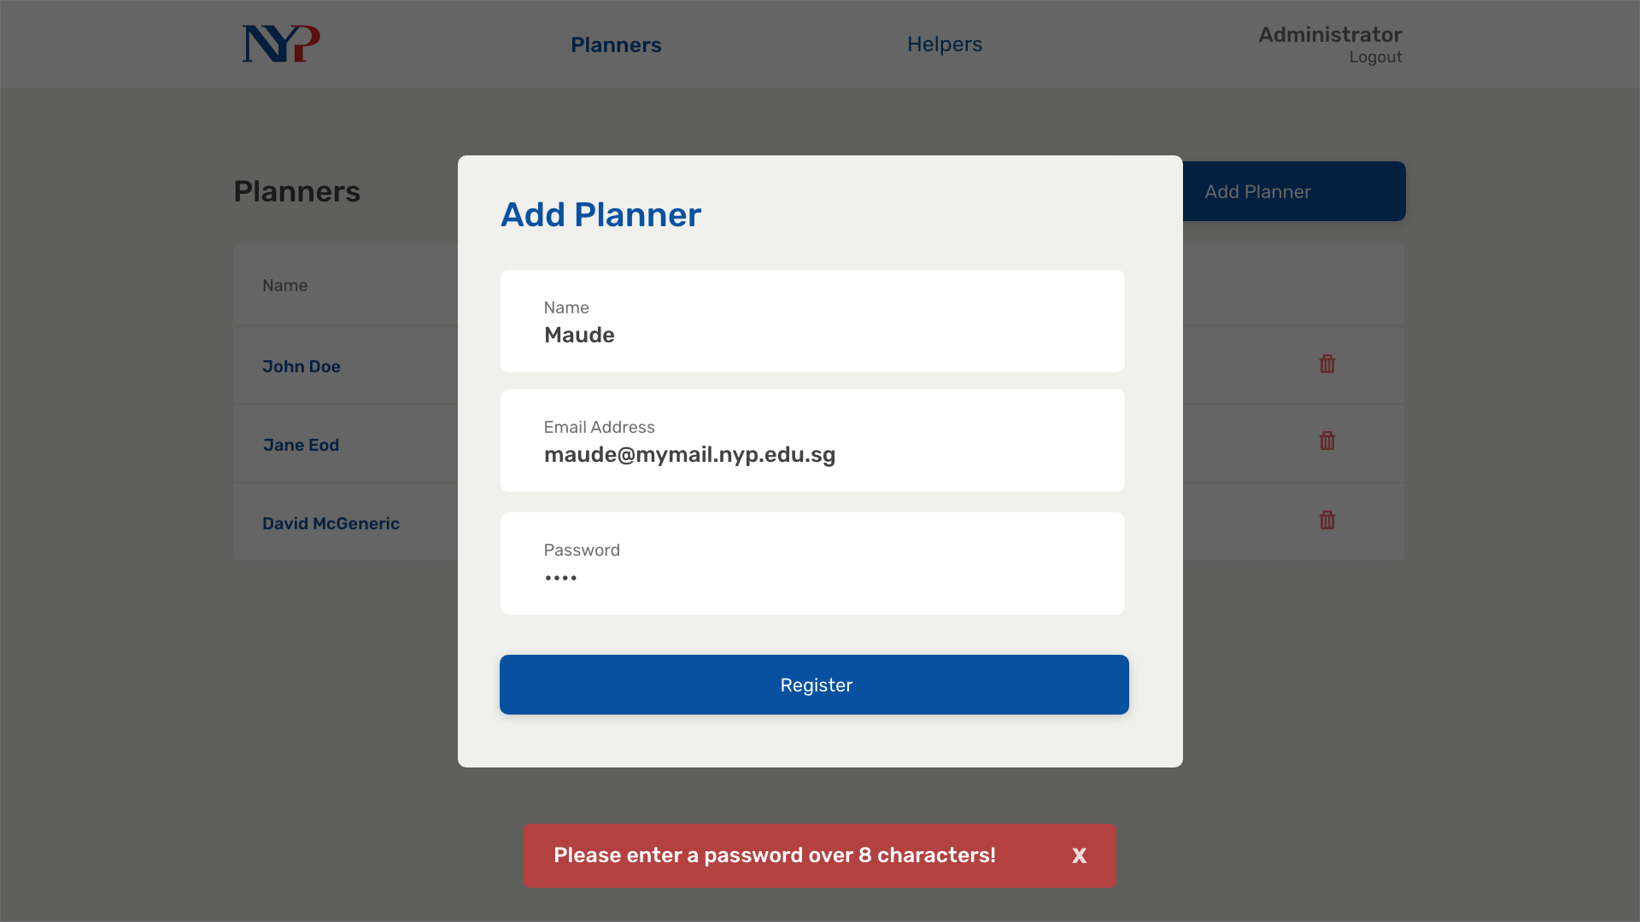
Notes:
58

Slide 65
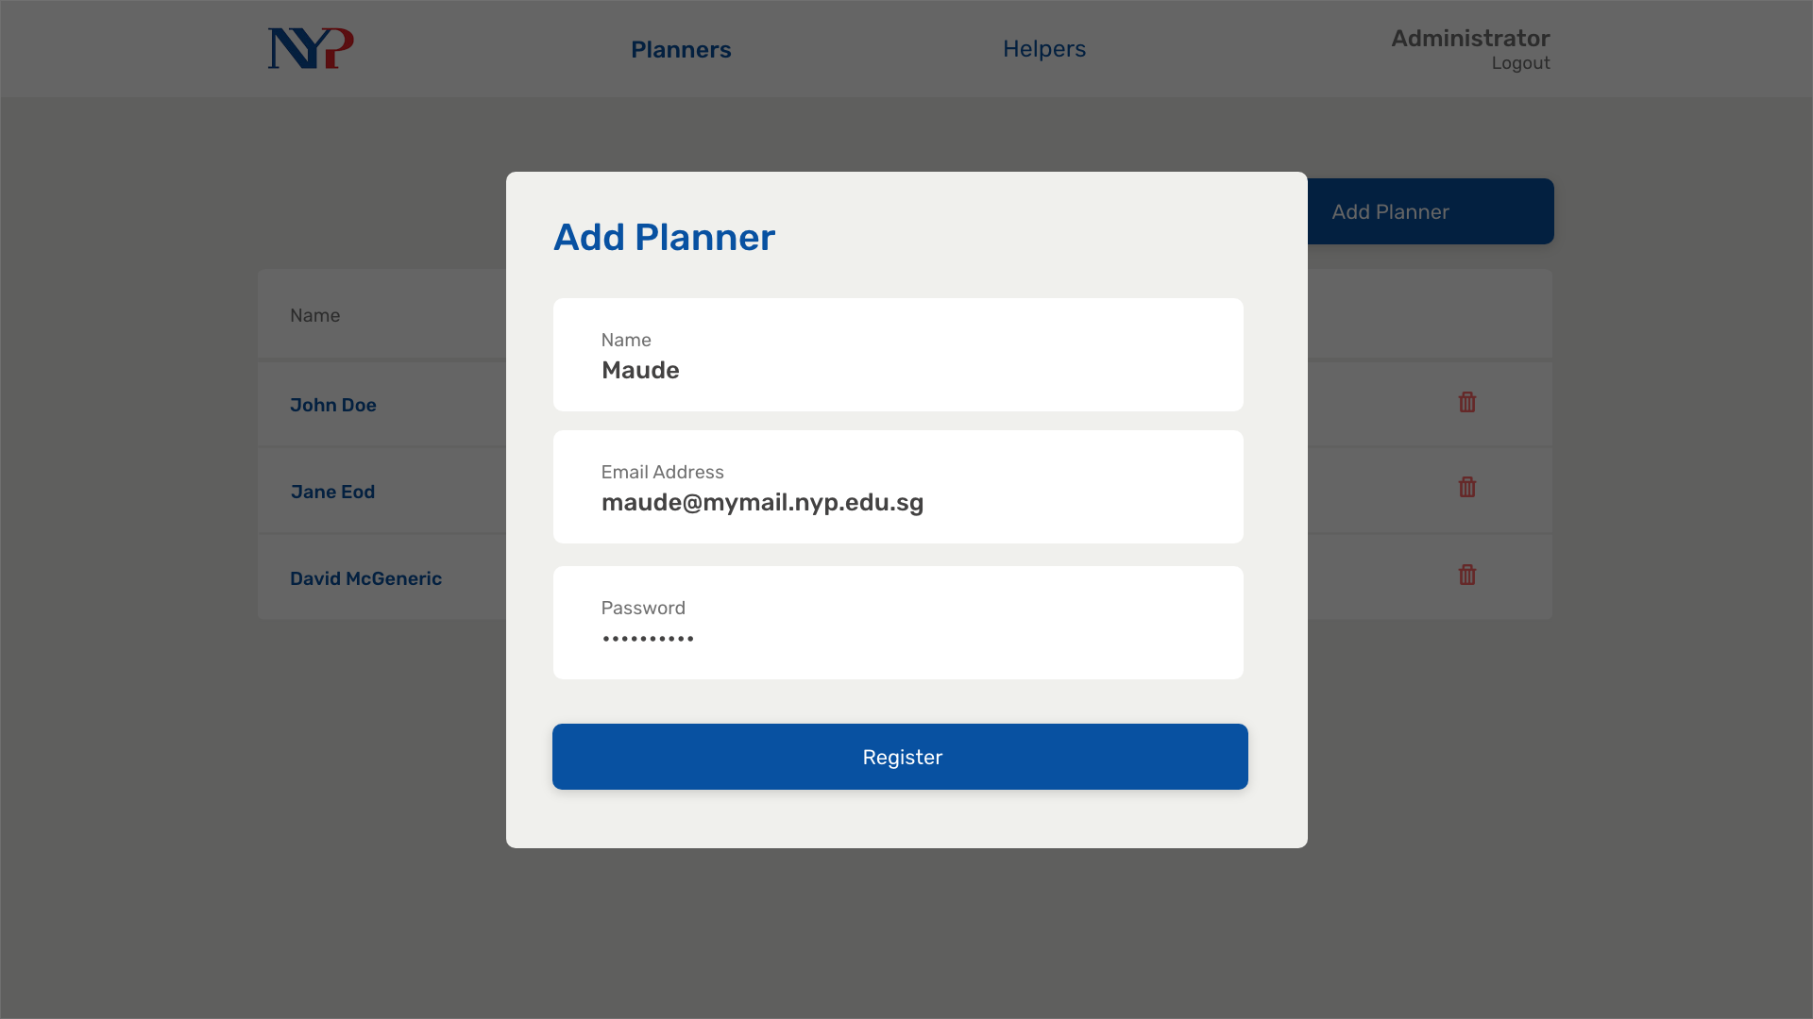
Notes:
59

Slide 66
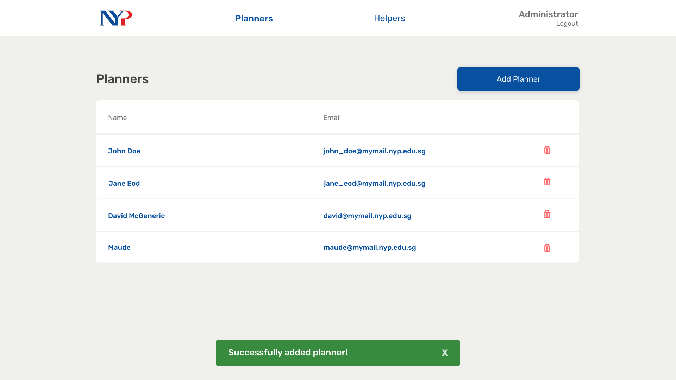
Notes:
60

Slide 67
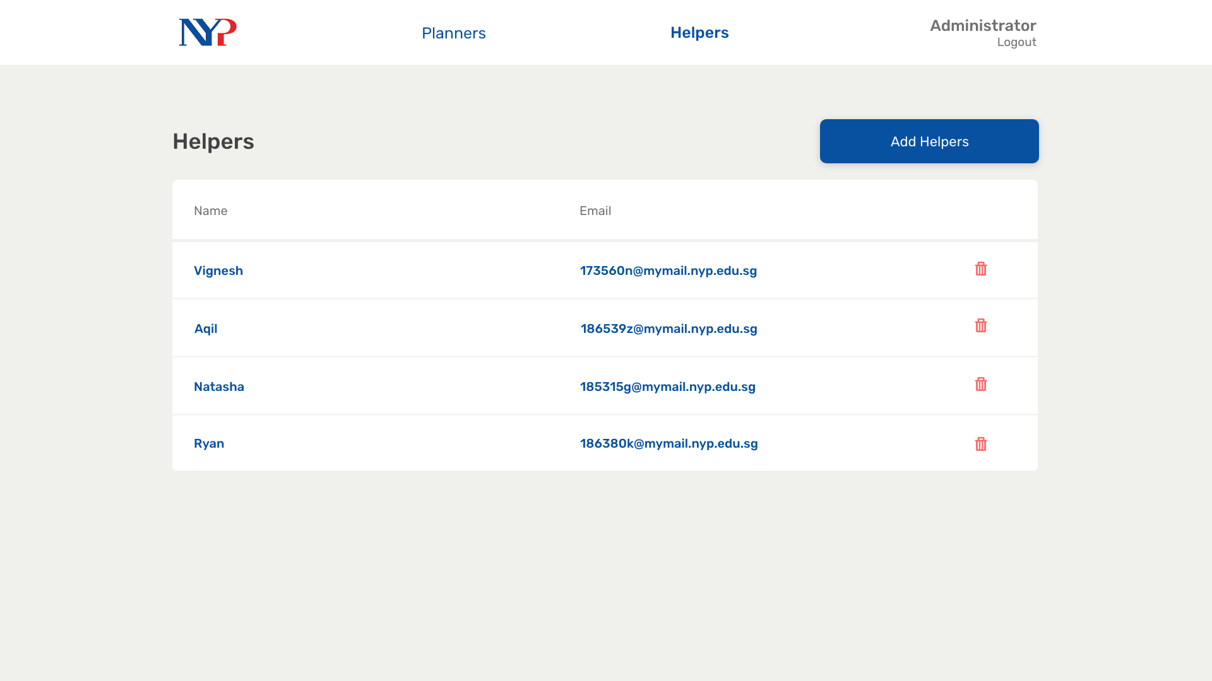
Notes:
61

Slide 68
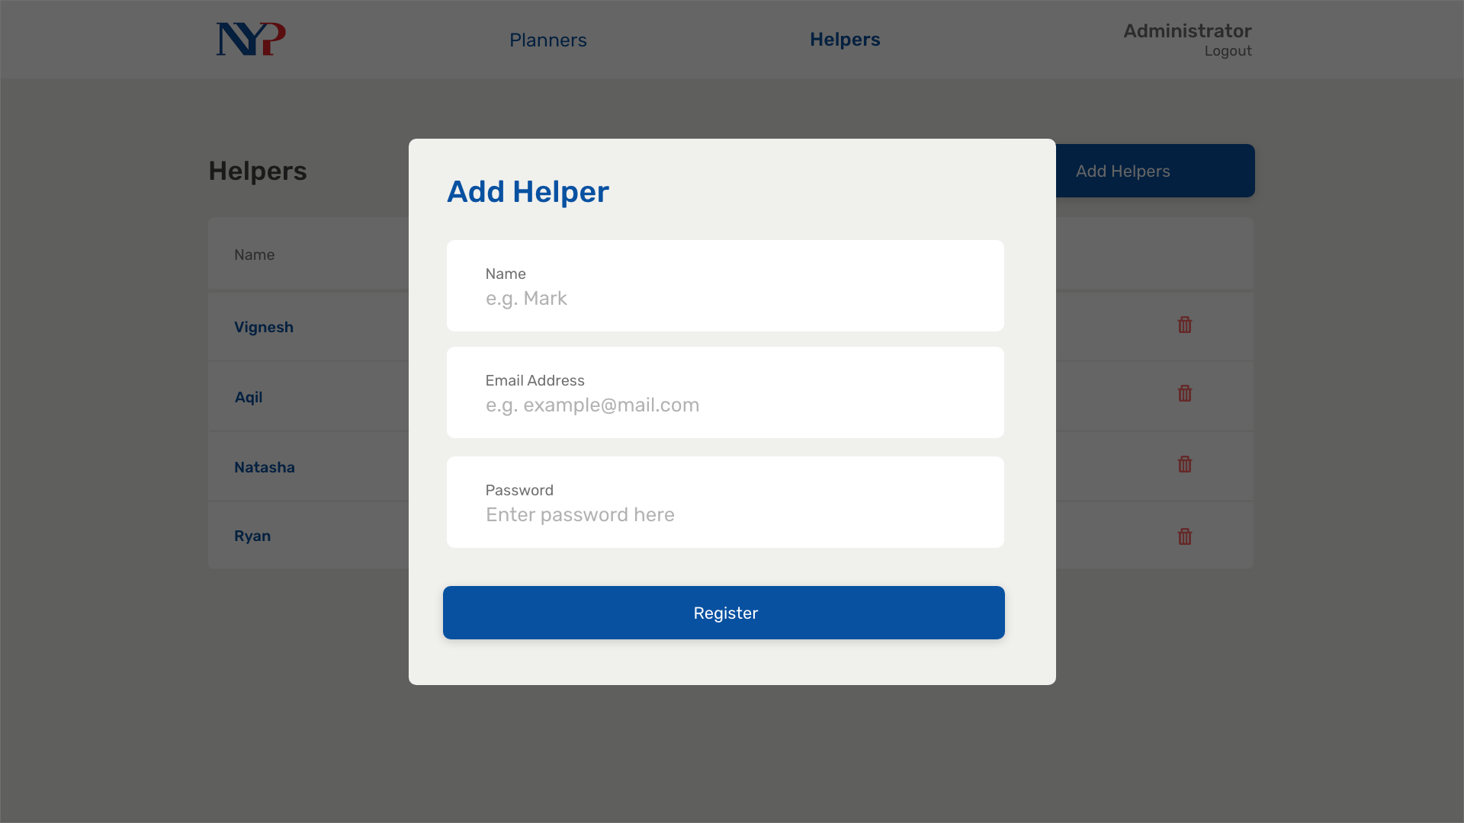
Notes:
62

Slide 69

Notes:
64

Slide 70
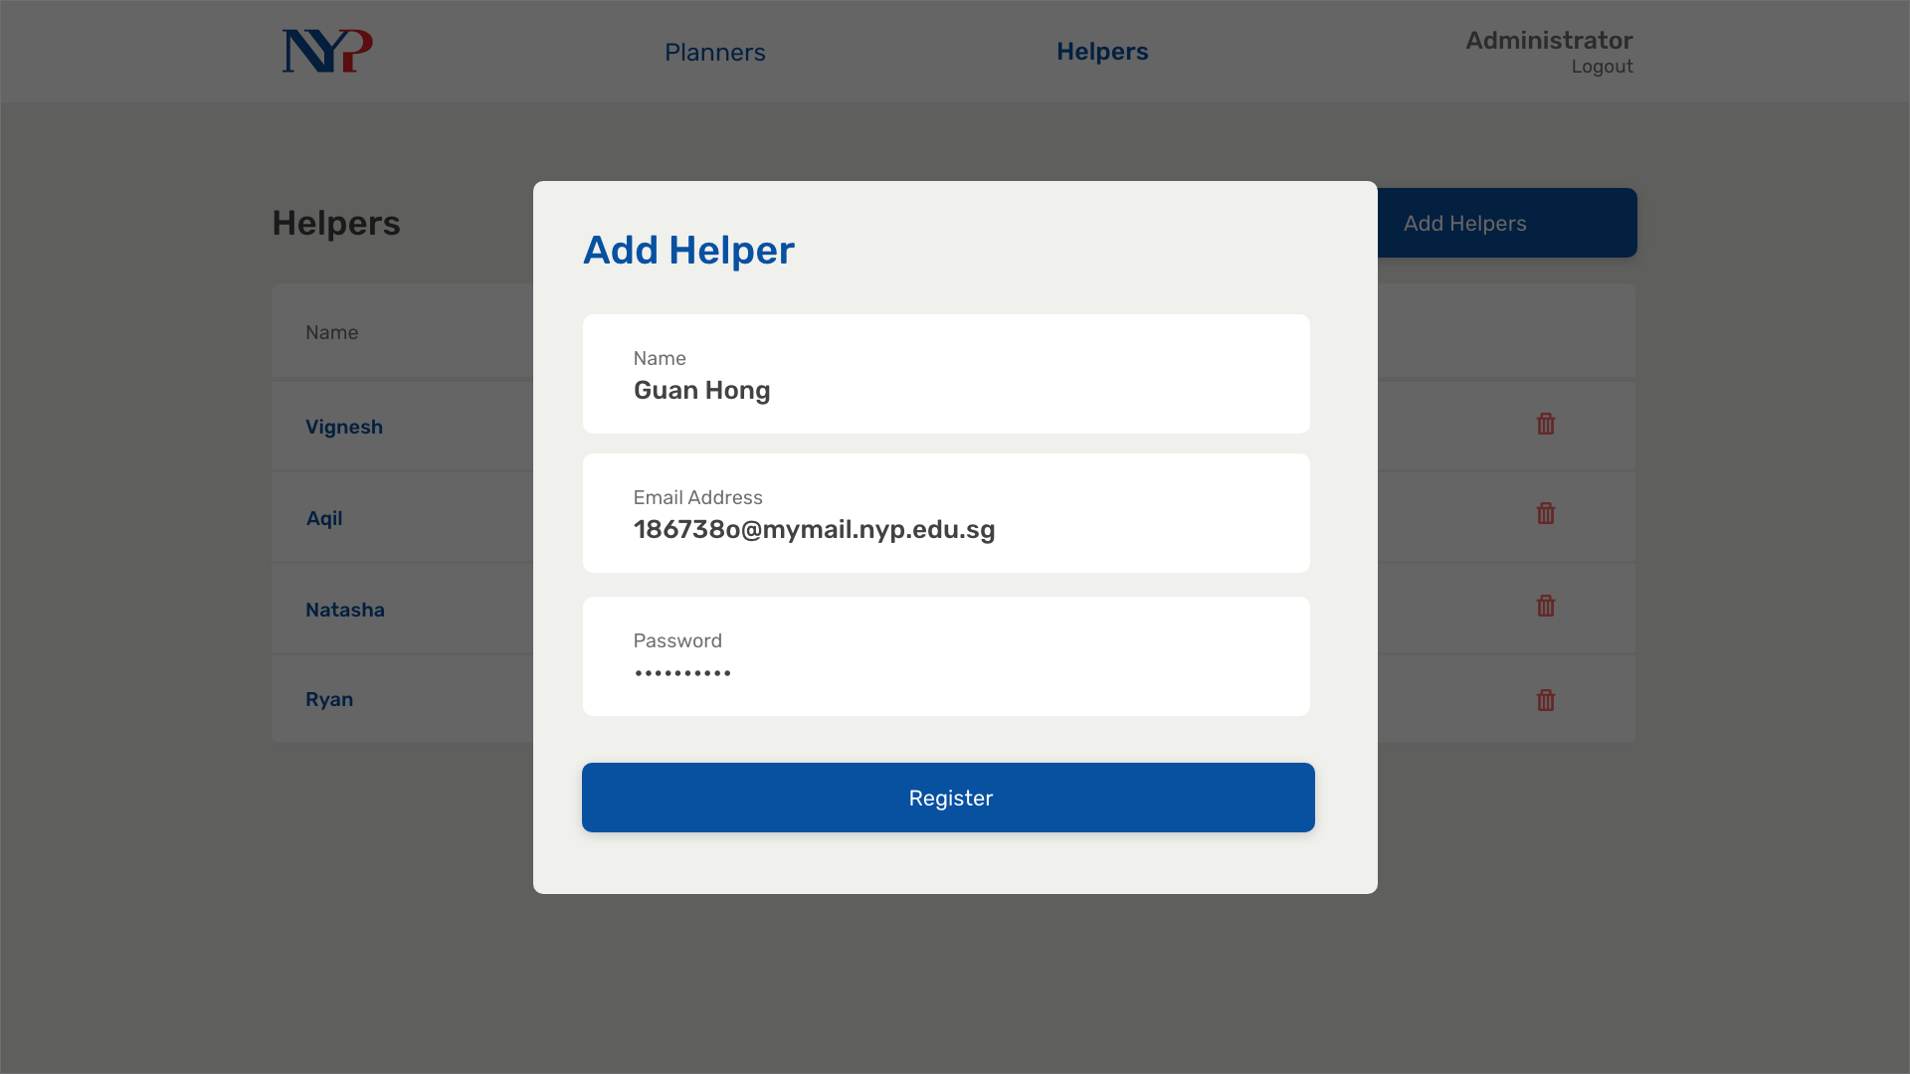
Notes:
63

